Slide 1

ASSIGNMENT- CSE326
JOB PORTAL FOR JOB SEEKERS AND RECRUITER
MEMBER : | PUNEET KUMAR, SHRADDHA GUPTA, TANMAY DIXIT
ROLL NO. : | 38,39,40
SECTION : | K23VM

Slide 2
JOB PORTAL : CONNECTING JOB SEEKERS AND RECRUITERS
“Revolutionizing Hiring and Job Searching Processes”

Slide 3
INDEX:
Introduction
Objective
Technologies used
Tools used
Features of Project
Preview of Website
Website source code
Conclusion
References

Slide 4
INTRODUCTION:
Project Overview: The job portal project aims to create a dynamic platform that serves as a bridge between job seekers and recruiters, facilitating seamless interactions and efficient hiring processes.
Purpose: At its core, the platform is designed to revolutionize the way job seekers explore career opportunities and how recruiters find potential candidates, fostering a symbiotic relationship.
Significance:
In today's competitive job market, the importance of a centralized platform cannot be overstated.
It addresses the challenges faced by job seekers in finding suitable opportunities and assists recruiters in identifying the right talent amidst a vast pool of candidates.

Slide 5
Empowering Job Seekers and Recruiters:
For job seekers, it offers a comprehensive array of job listings, tools for resume building, and an avenue to showcase their skills.
For recruiters, it provides access to a diverse talent pool, advanced search functionalities, and streamlined applicant tracking systems.
Enhancing Efficiency:
By integrating modern technologies, the platform aims to enhance the efficiency of the job search and recruitment processes, reducing time-to-hire and improving the quality of placements.
User-Centric Approach:
The development of the platform follows a user-centric design philosophy, ensuring a seamless and intuitive experience for both job seekers and recruiters.

Slide 6
TECHNOLOGIES USED:
Core Technologies: HTML, CSS, and JavaScript
HTML (Hypertext Markup Language):
Role: Forms the structural foundation of the job portal's frontend.
Purpose: Defines the layout, structure, and content of web pages.
Usage: Organizes elements such as headings, paragraphs, forms, and lists.
CSS (Cascading Style Sheets):
Role: Controls the visual presentation and styling of the job portal.
Purpose: Defines colors, fonts, layouts, and visual elements.
Usage: Ensures a consistent and appealing design across the platform.

Slide 7
JavaScript:
Role: Adds interactivity and dynamic functionalities to the job portal.
Purpose: Enables real-time updates, interactive features, and asynchronous requests.
Usage: Facilitates user interactions like form validations, animations, and dynamic content generation.
Collaborative Integration:
Interplay: HTML provides the structure, CSS styles the elements, and JavaScript adds interactivity, creating a cohesive and user-friendly frontend experience.

Slide 8
TOOLS USED:
Note Pad
Used for creating html and CSS pages.
VS Code
A powerful, versatile, and free tool for web design, offering syntax highlighting, code completion, live preview, Emmet support, debugging tools, and a vast extension library.

Slide 9
FEATURES OF PROJECT:
User Registration and Profiles
User Registration:
Seamless registration process for candidates and employers, collecting essential details for profile creation.
User Profiles:
Customizable profiles allowing candidates to showcase their skills, experience, and preferences.
Employer profiles facilitating detailed company information, job postings, and recruitment preferences.

Slide 10
Job Search and Filtering Options
Advanced Search Tools:
Various filters enabling candidates to refine job searches based on industry, location, salary, experience, etc.
Saved Searches:
Functionality allowing users to save and revisit specific job search criteria for future use.

Slide 11
Company Profiles and Job Postings
Job Profiles:
Detailed job pages showcasing information about employers, culture, and current job openings.
Job Postings:
Feature for employers to create, edit, and manage job listings, including descriptions, requirements, and application deadlines.

Slide 12
Website Preview:

Slide 13
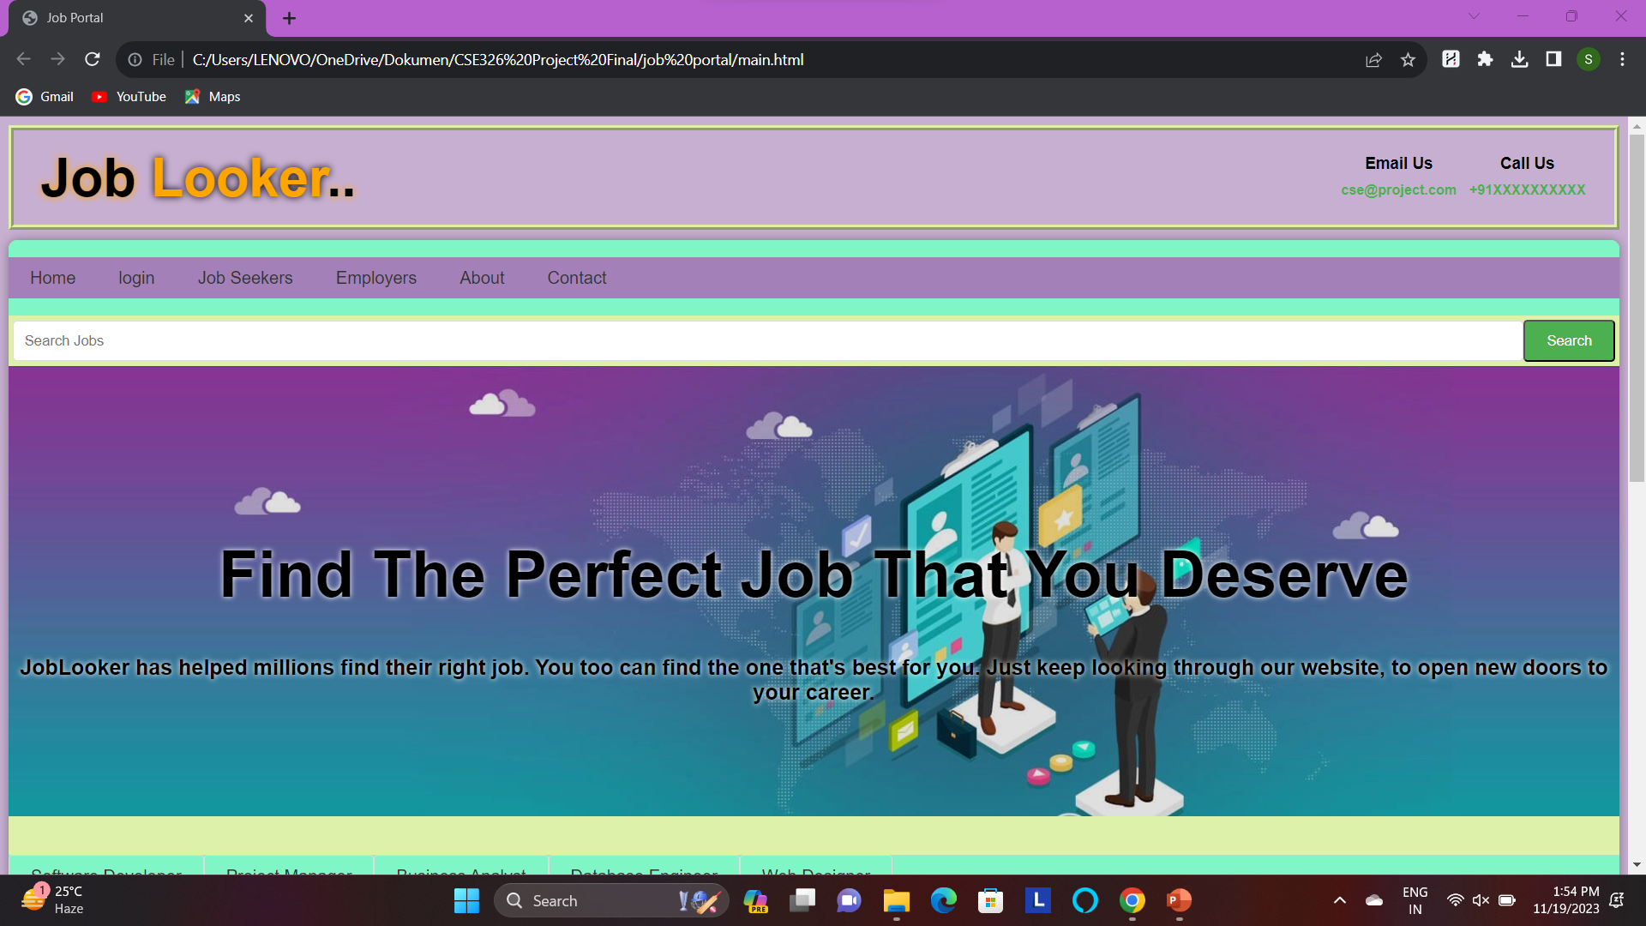

Slide 14
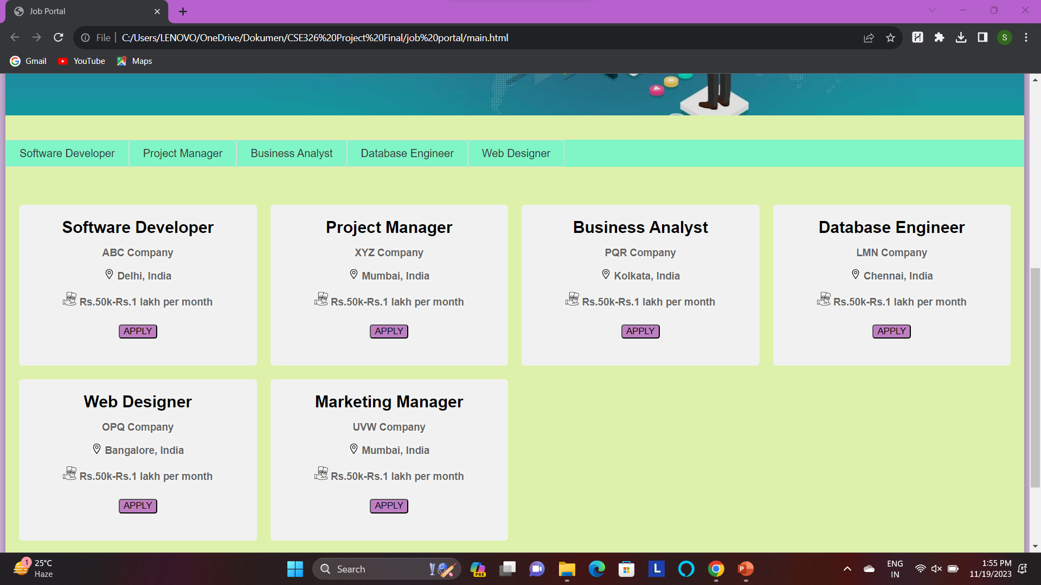

Slide 15
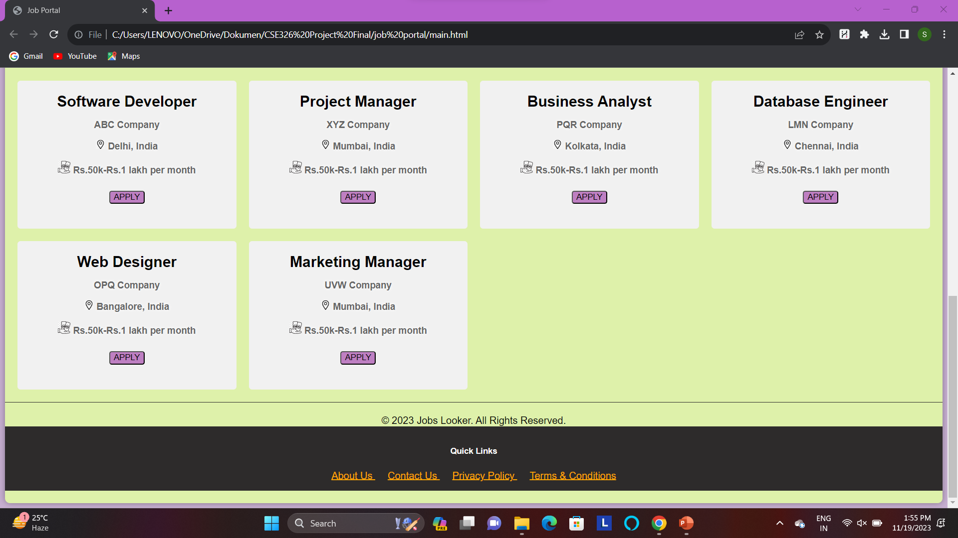

Slide 16
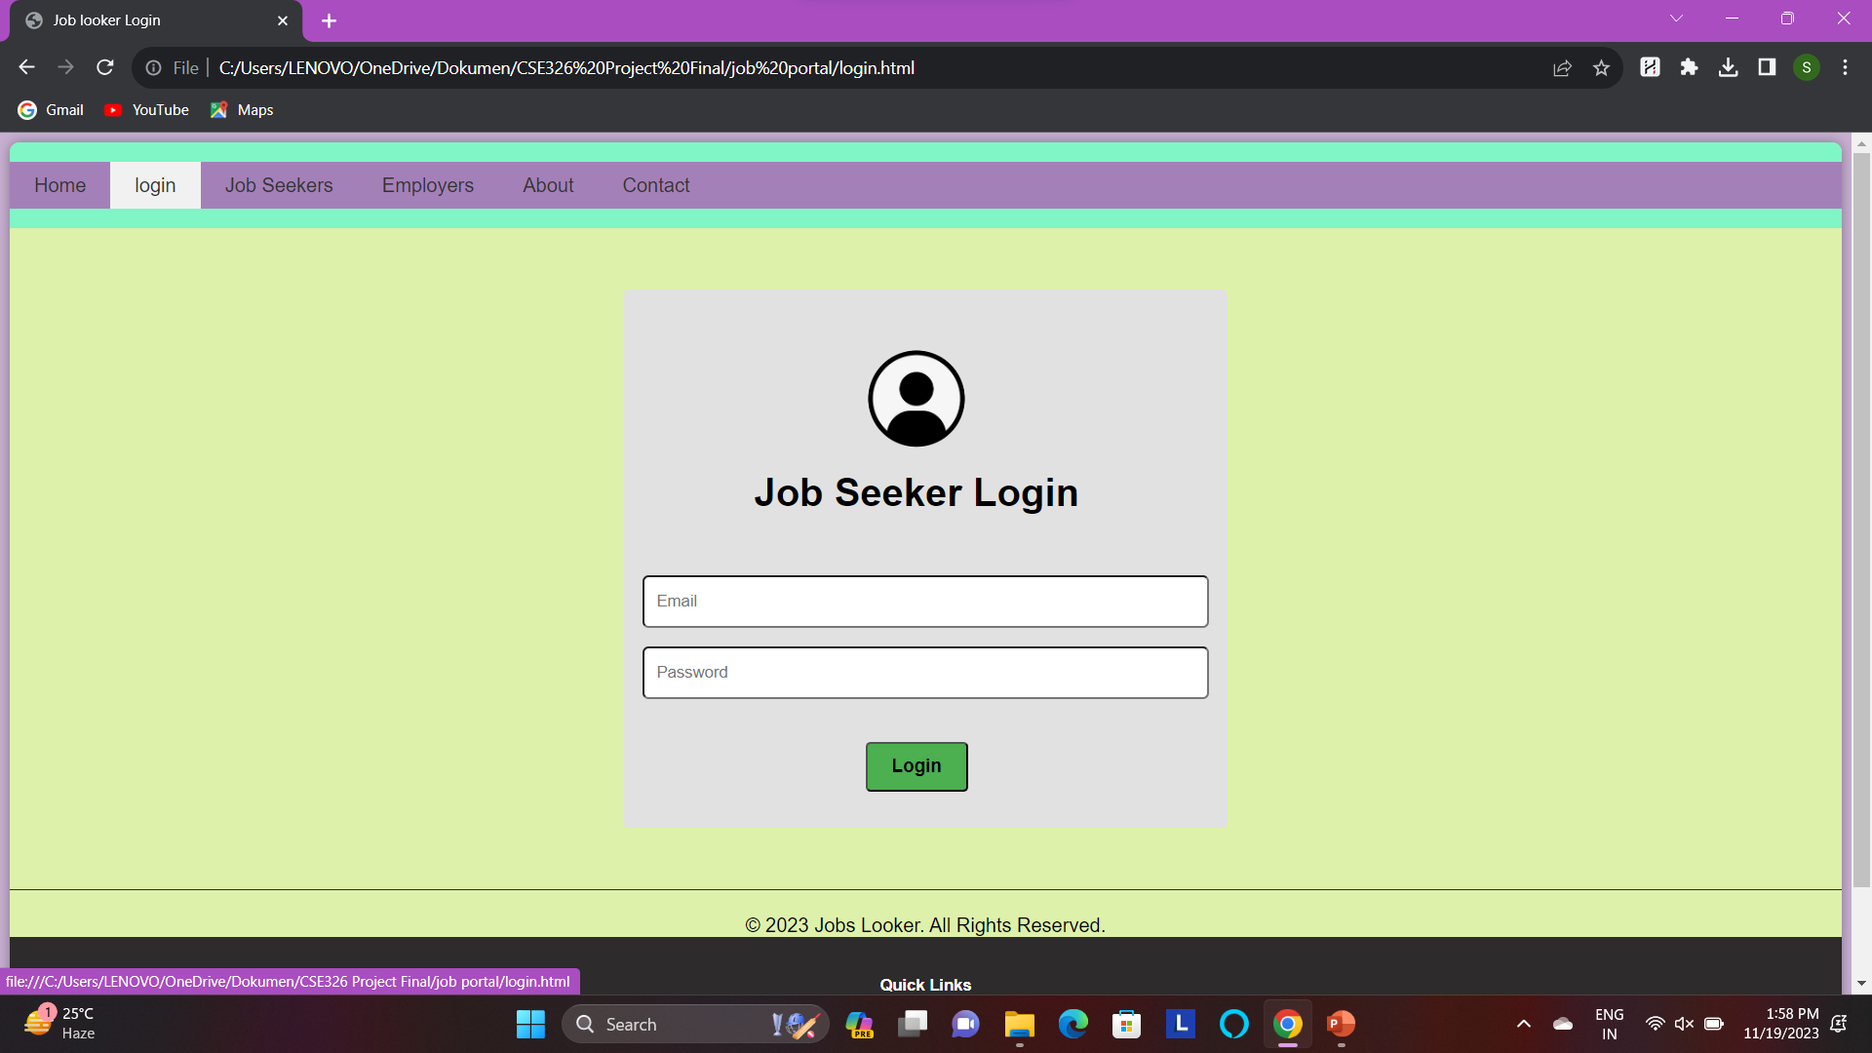

Slide 17
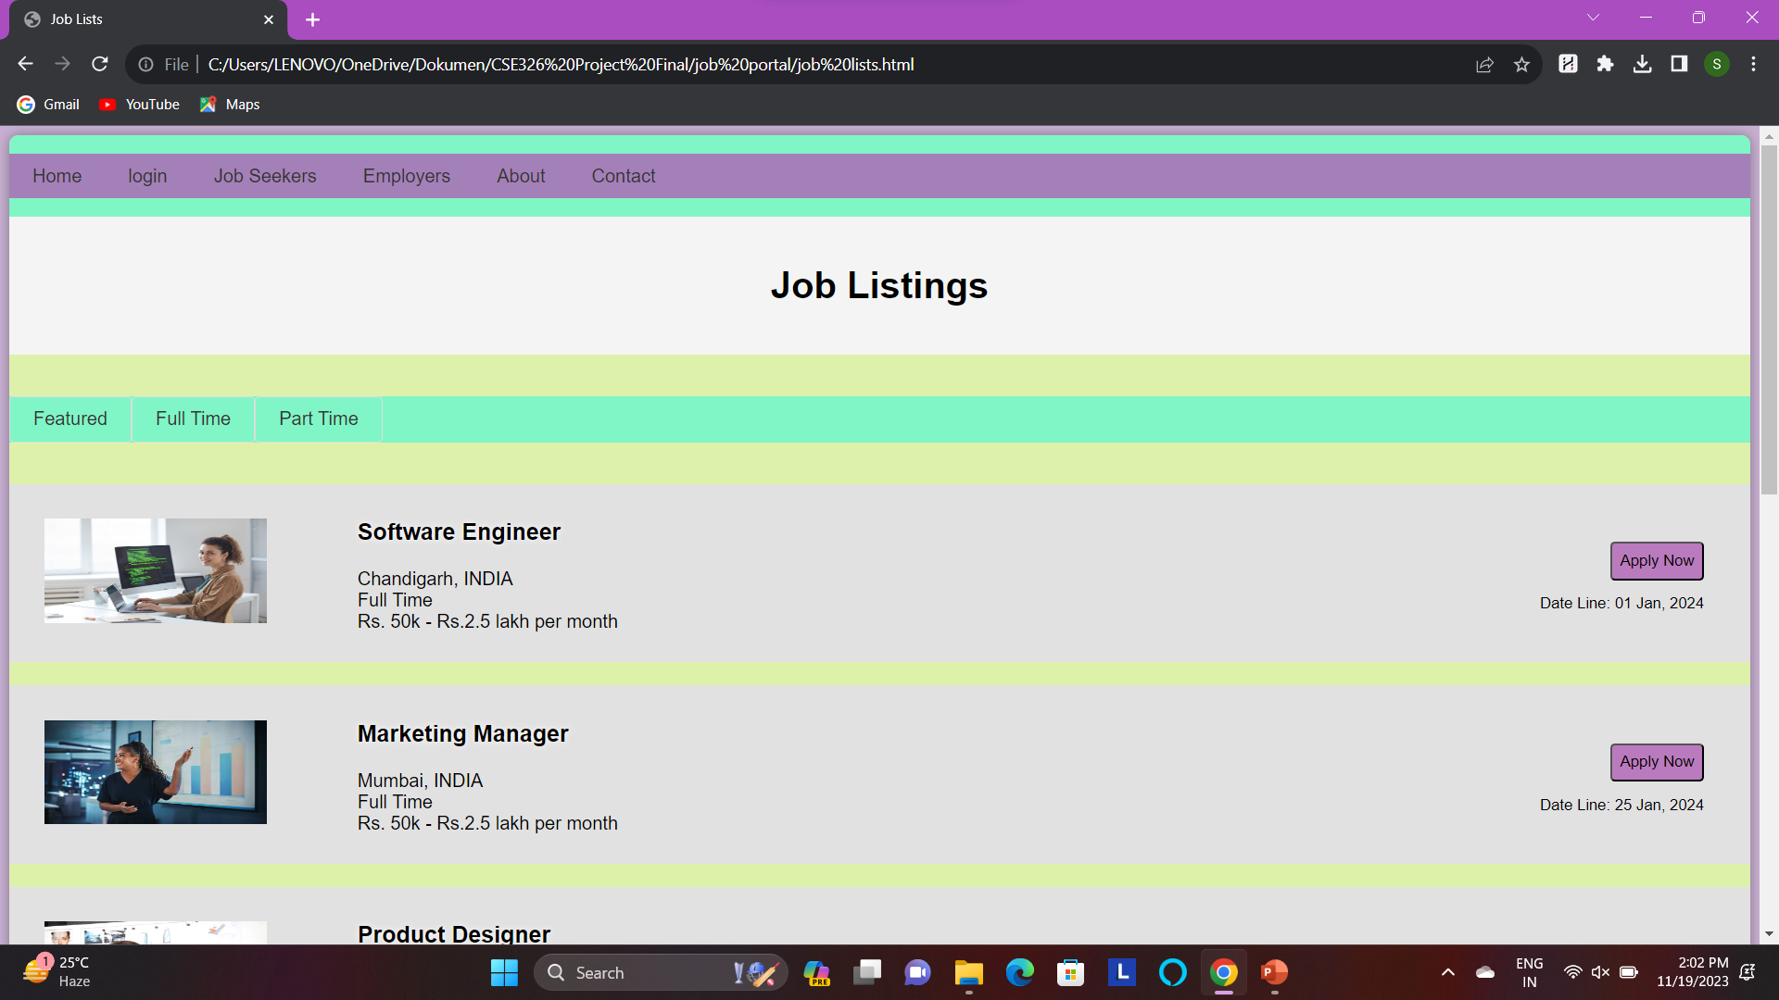

Slide 18
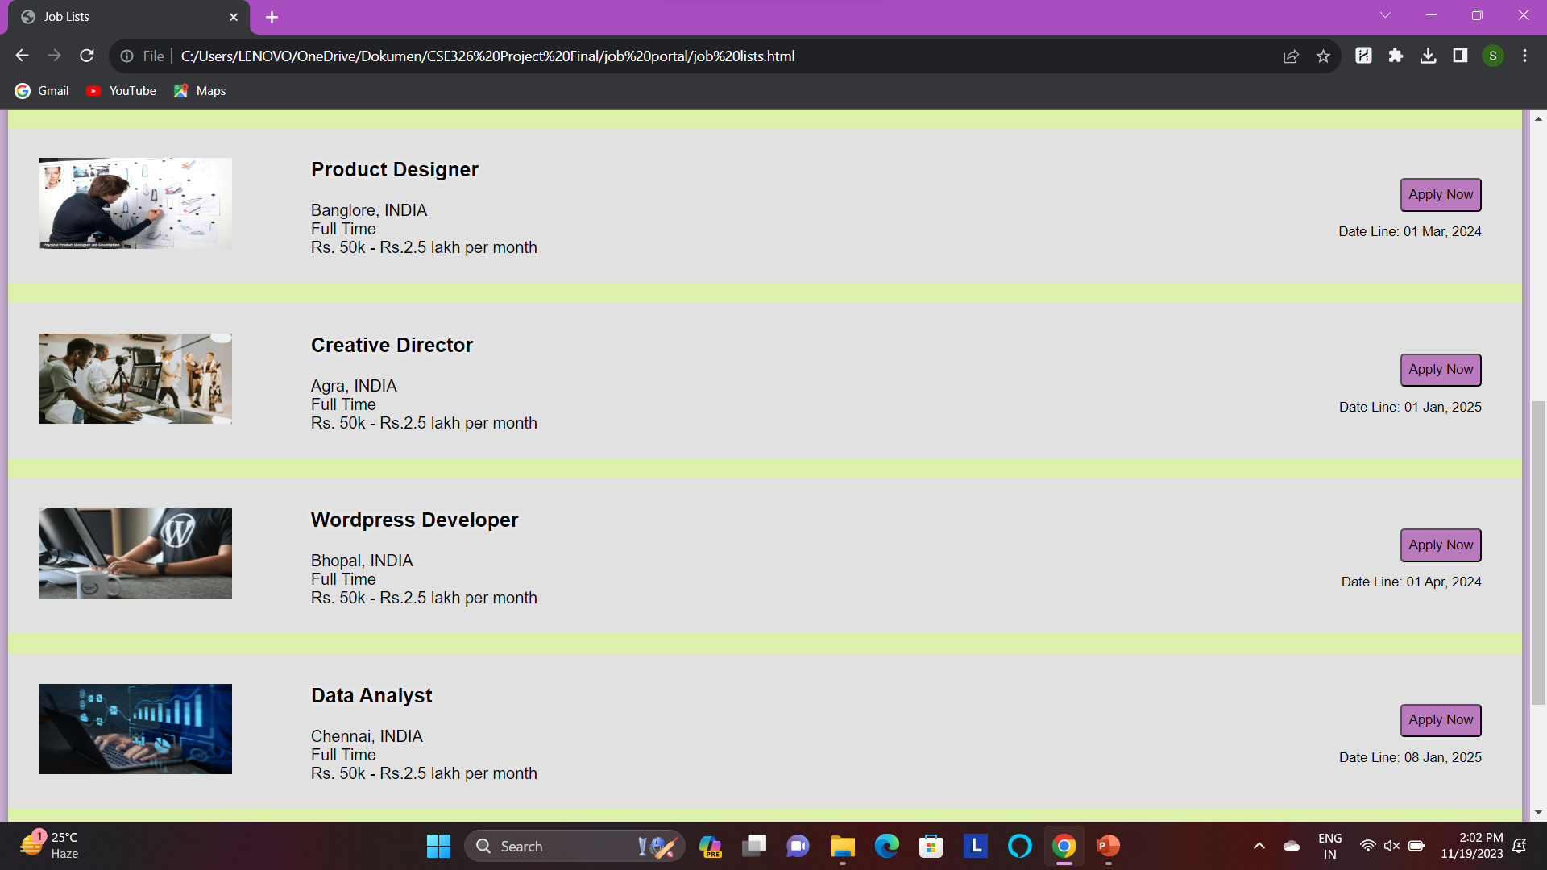

Slide 19
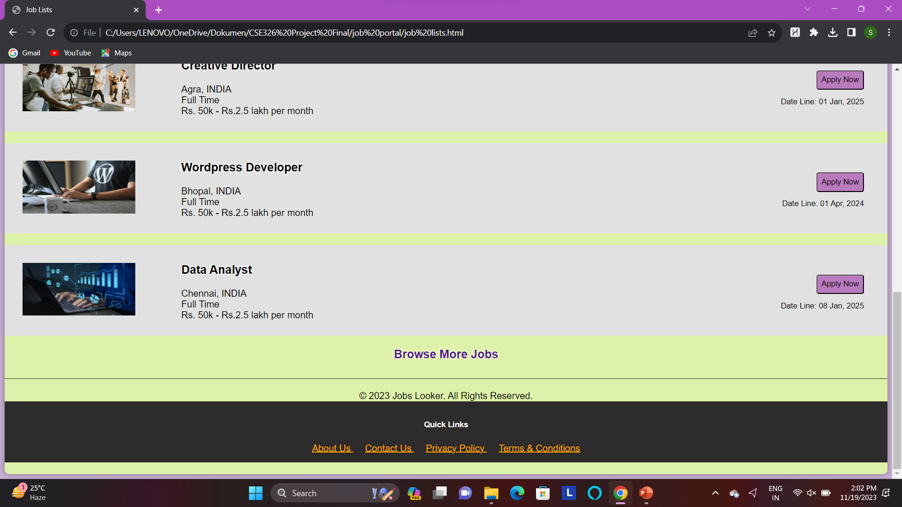

Slide 20
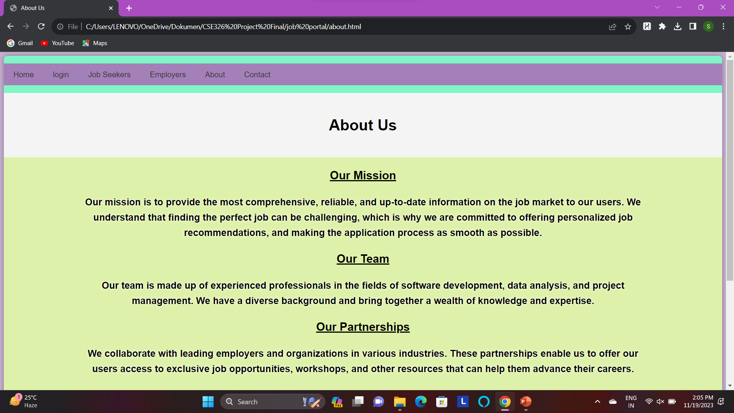

Slide 21
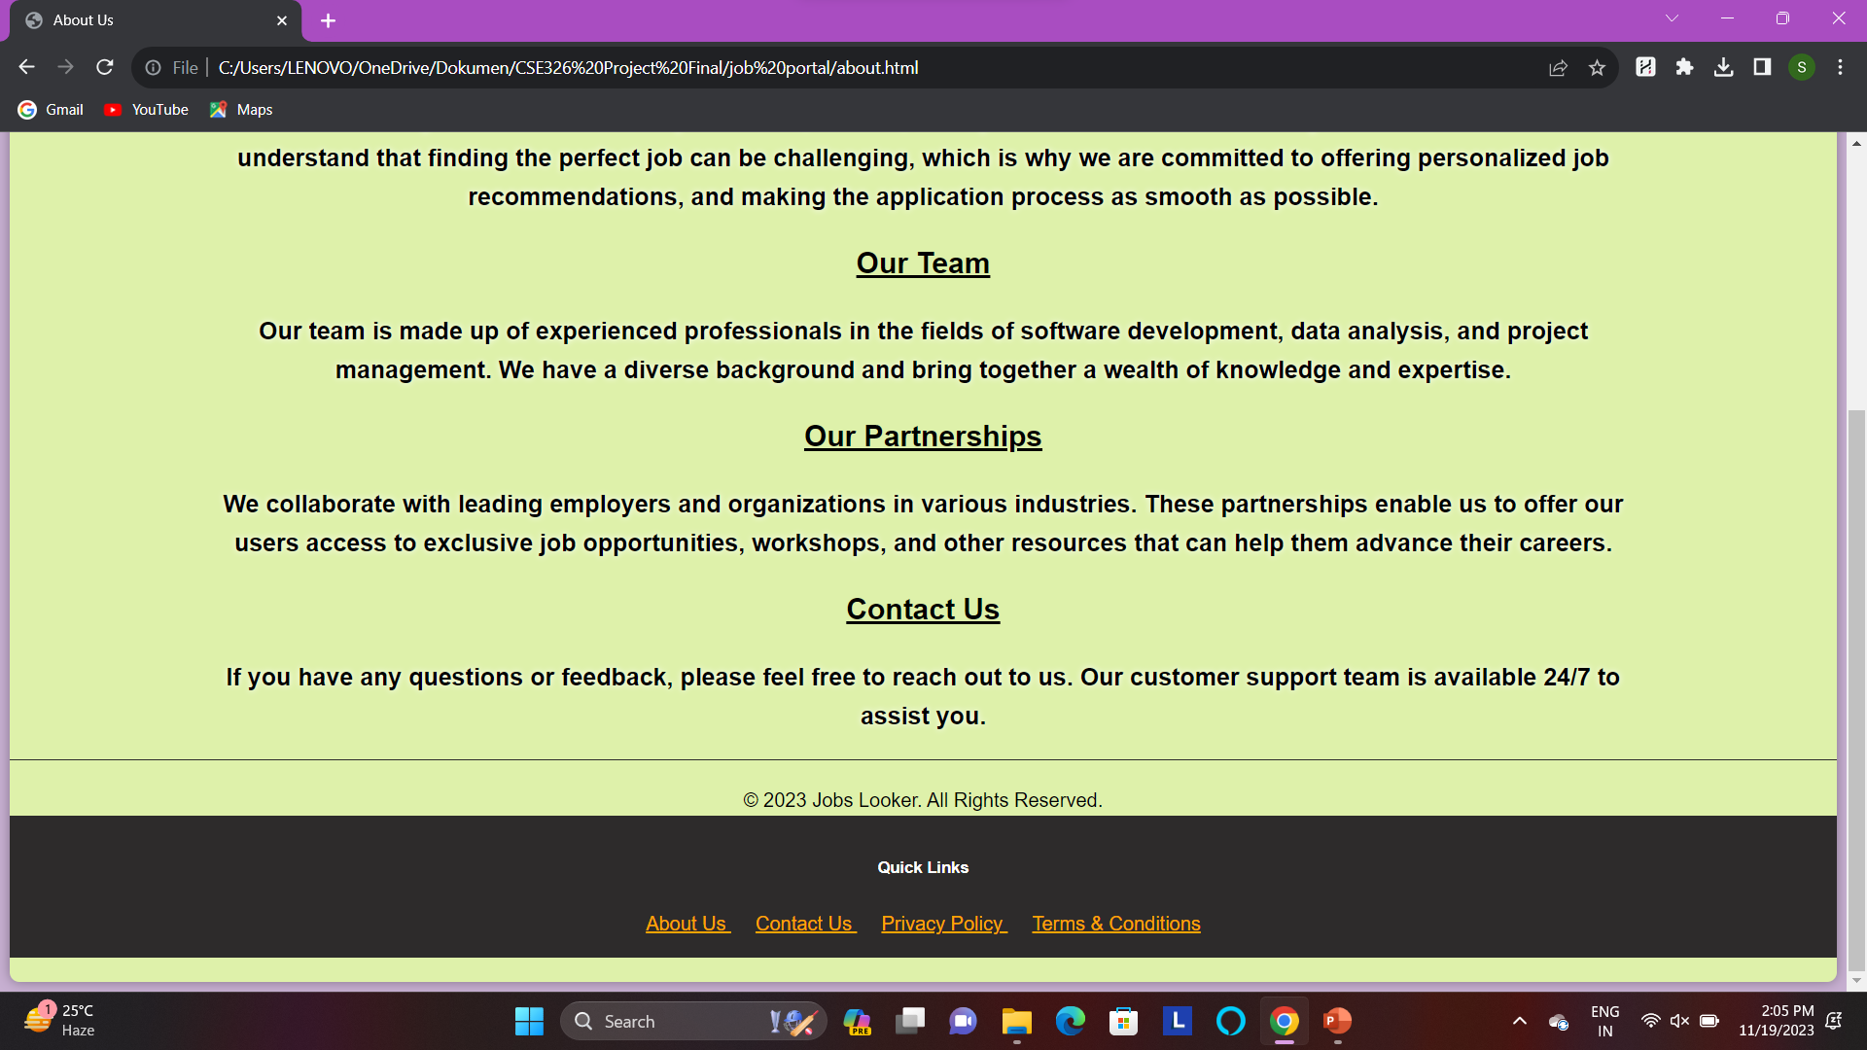

Slide 22
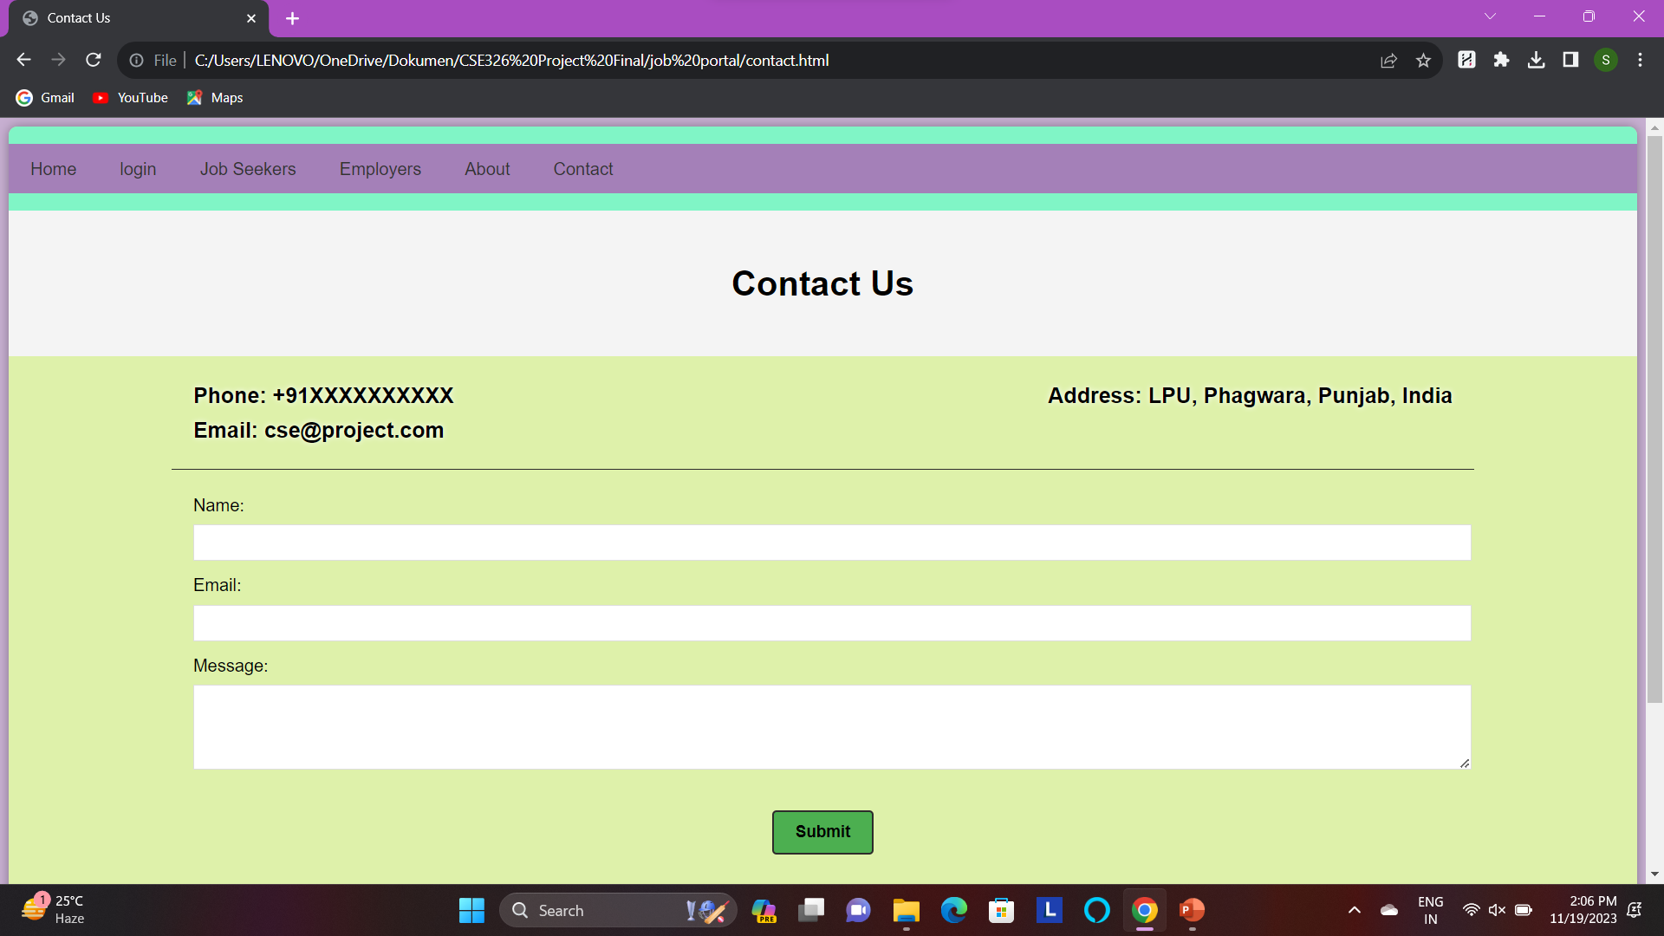

Slide 23
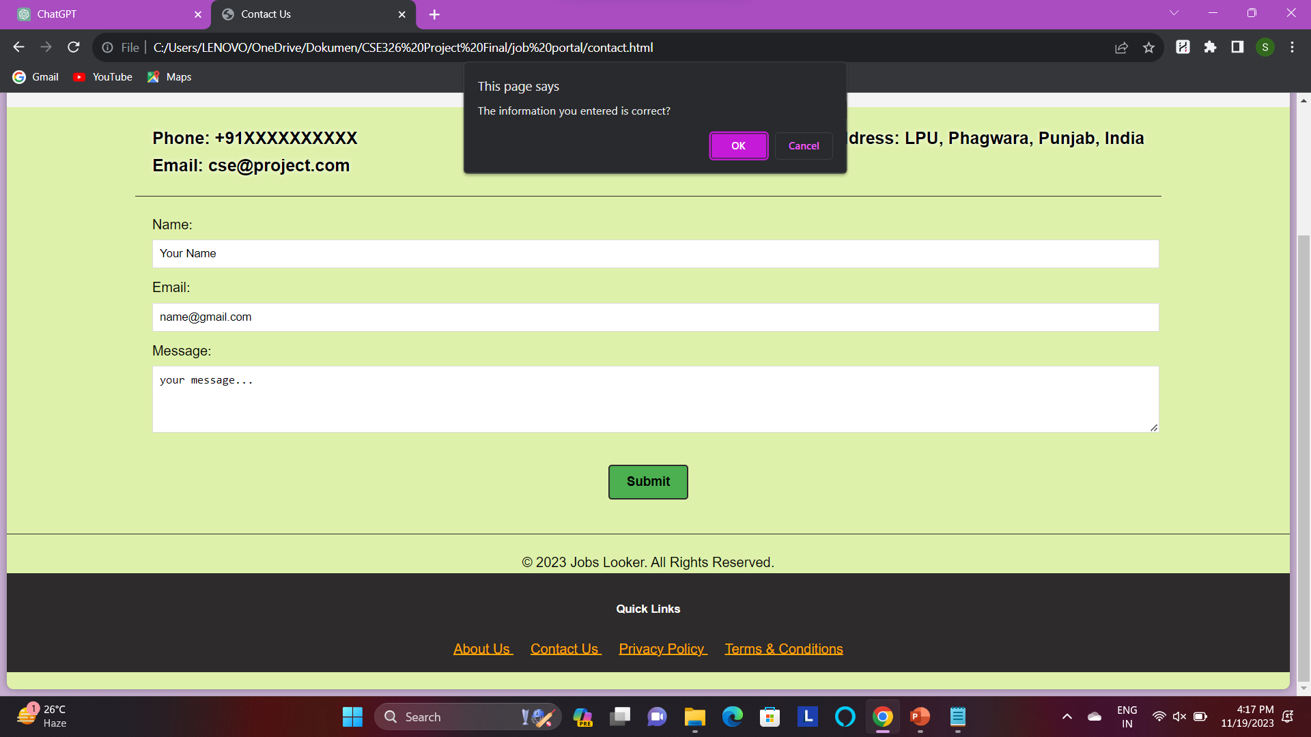

Slide 24
Website Source Code:

Slide 25
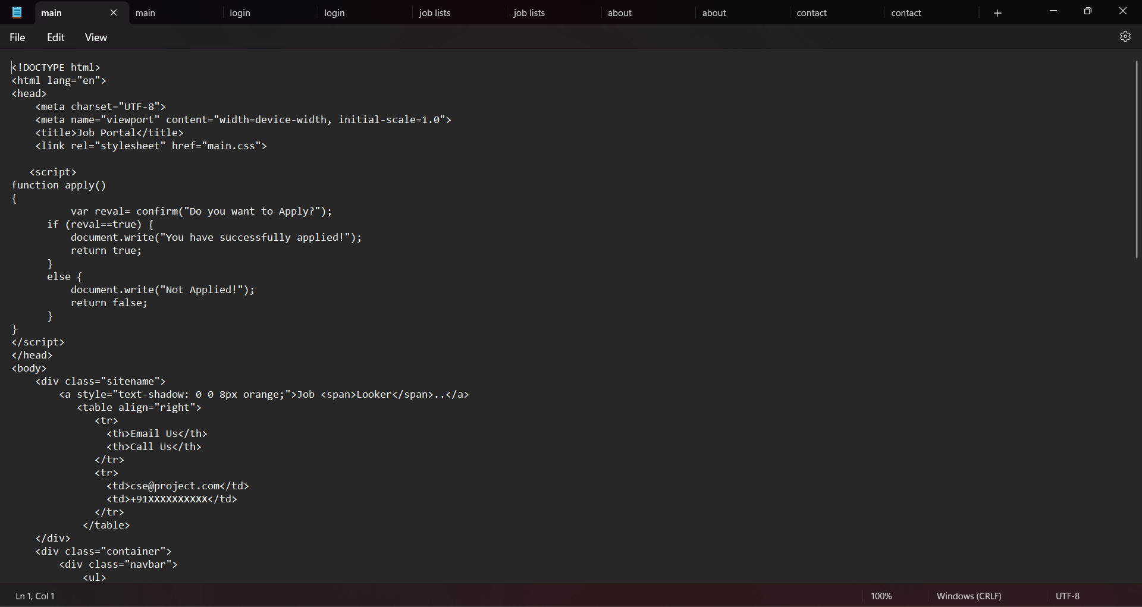

Slide 26
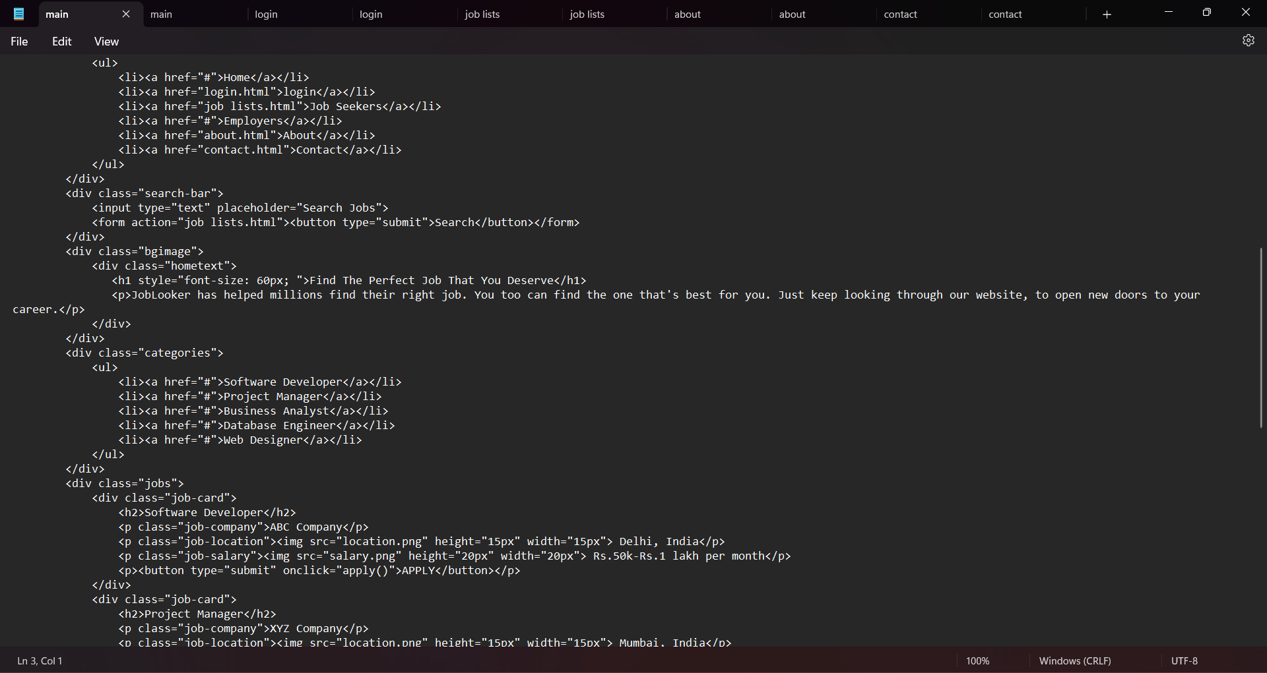

Slide 27
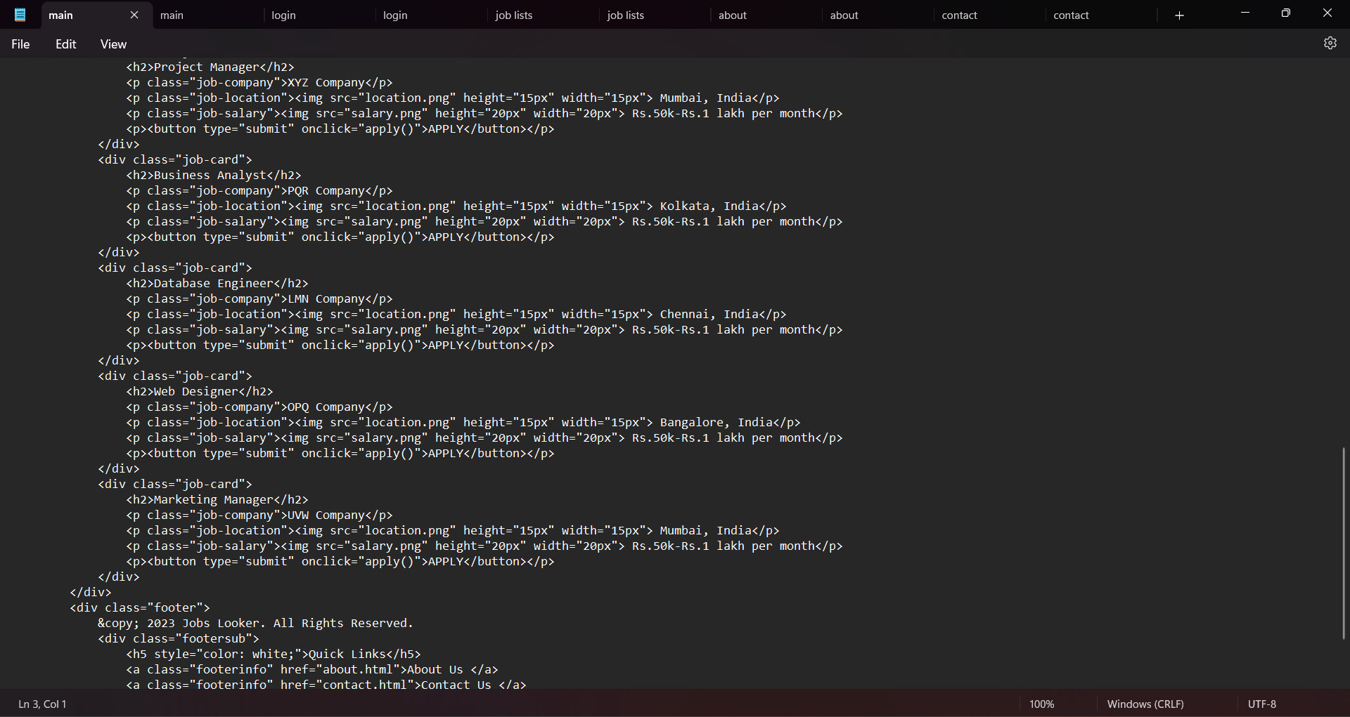

Slide 28
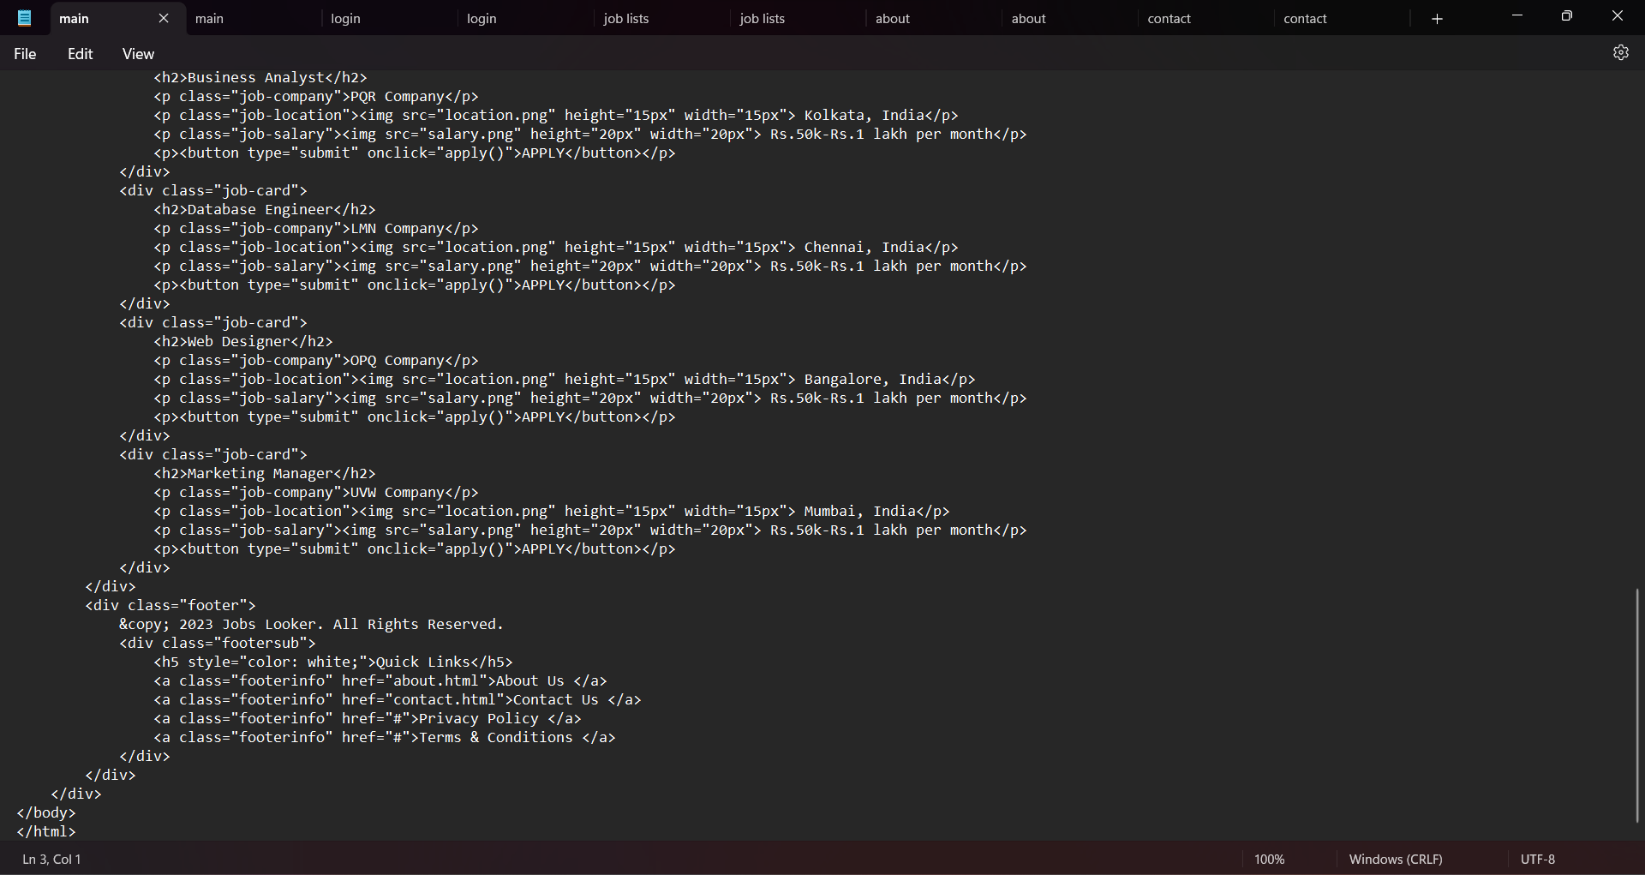

Slide 29
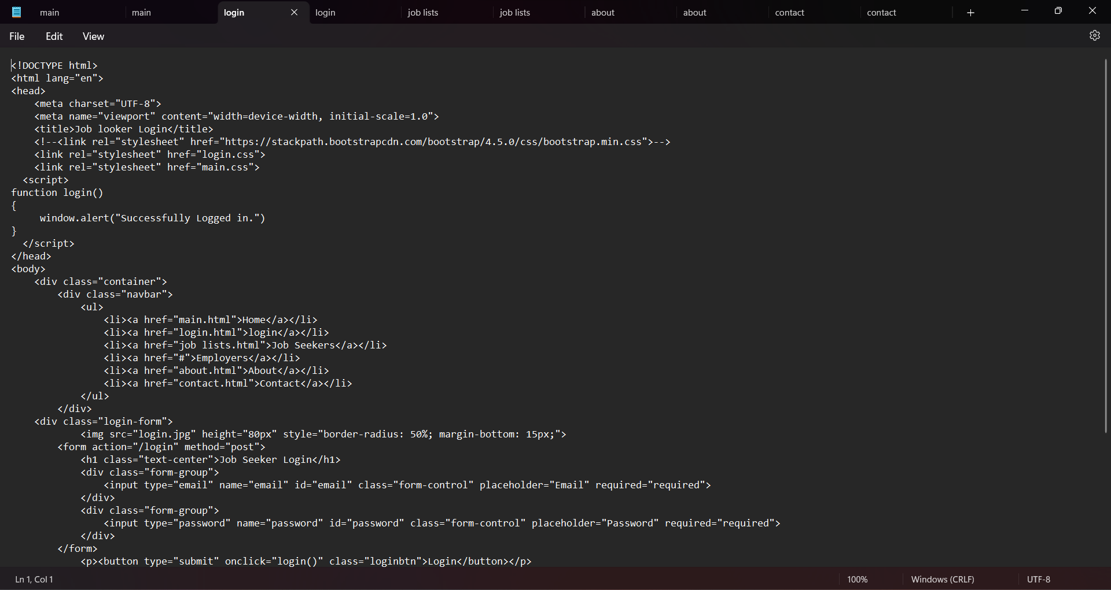

Slide 30
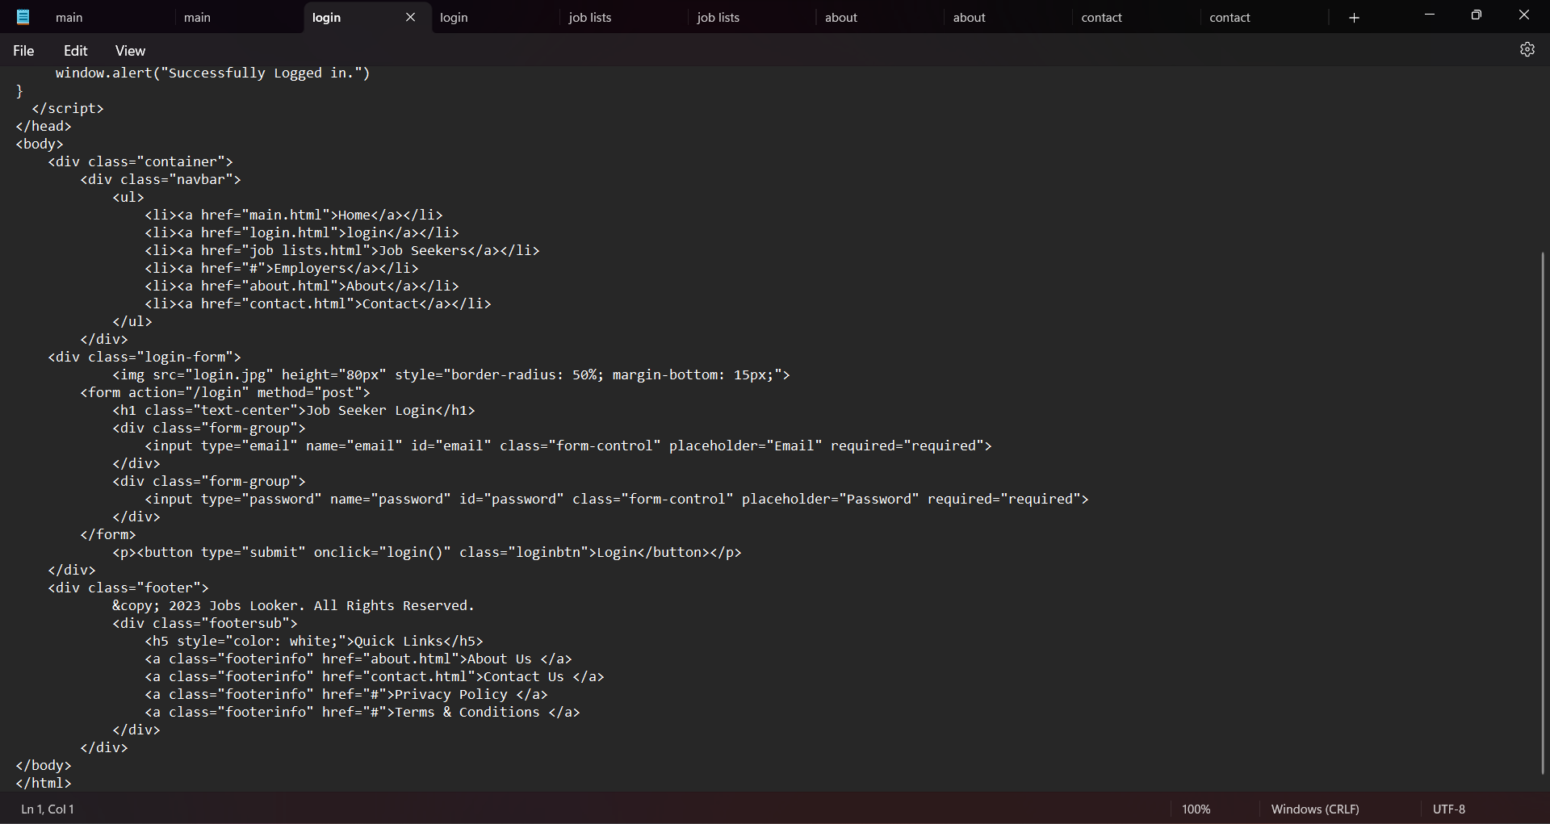

Slide 31
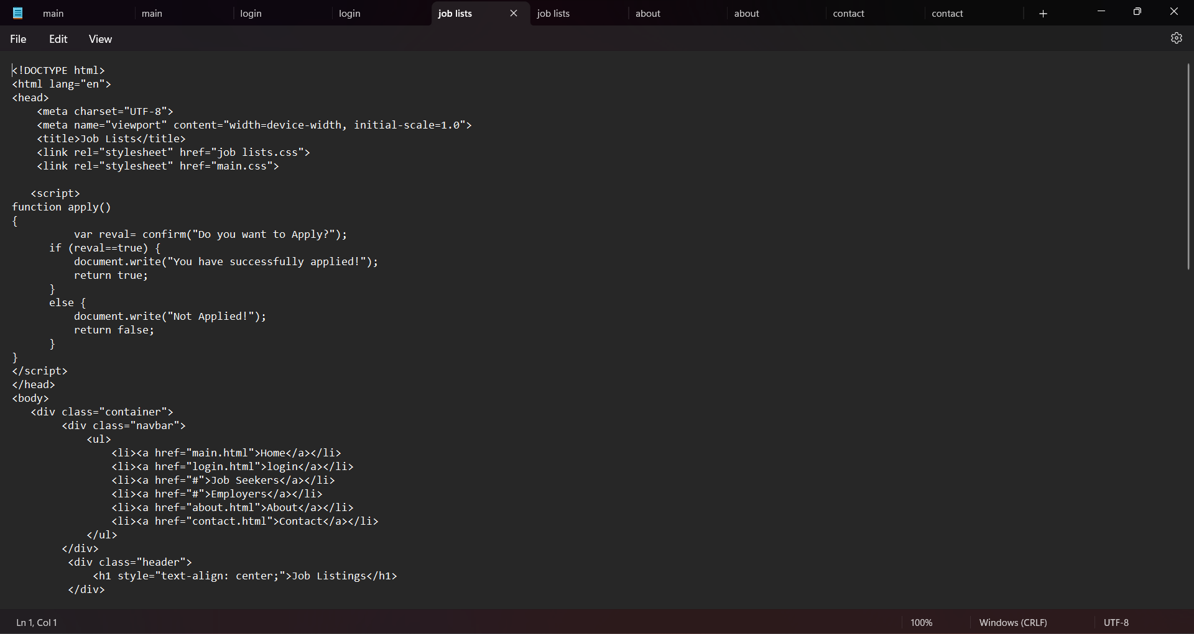

Slide 32
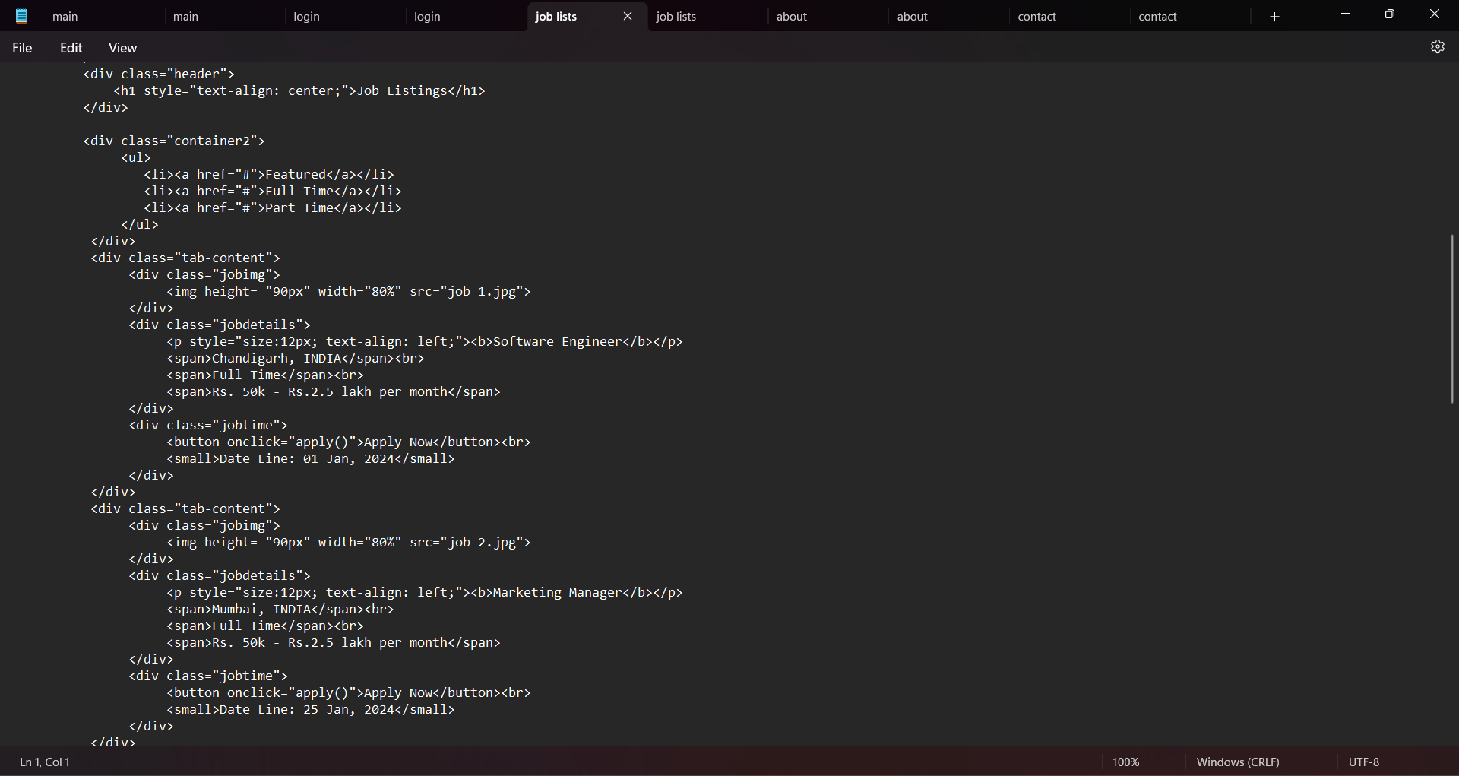

Slide 33
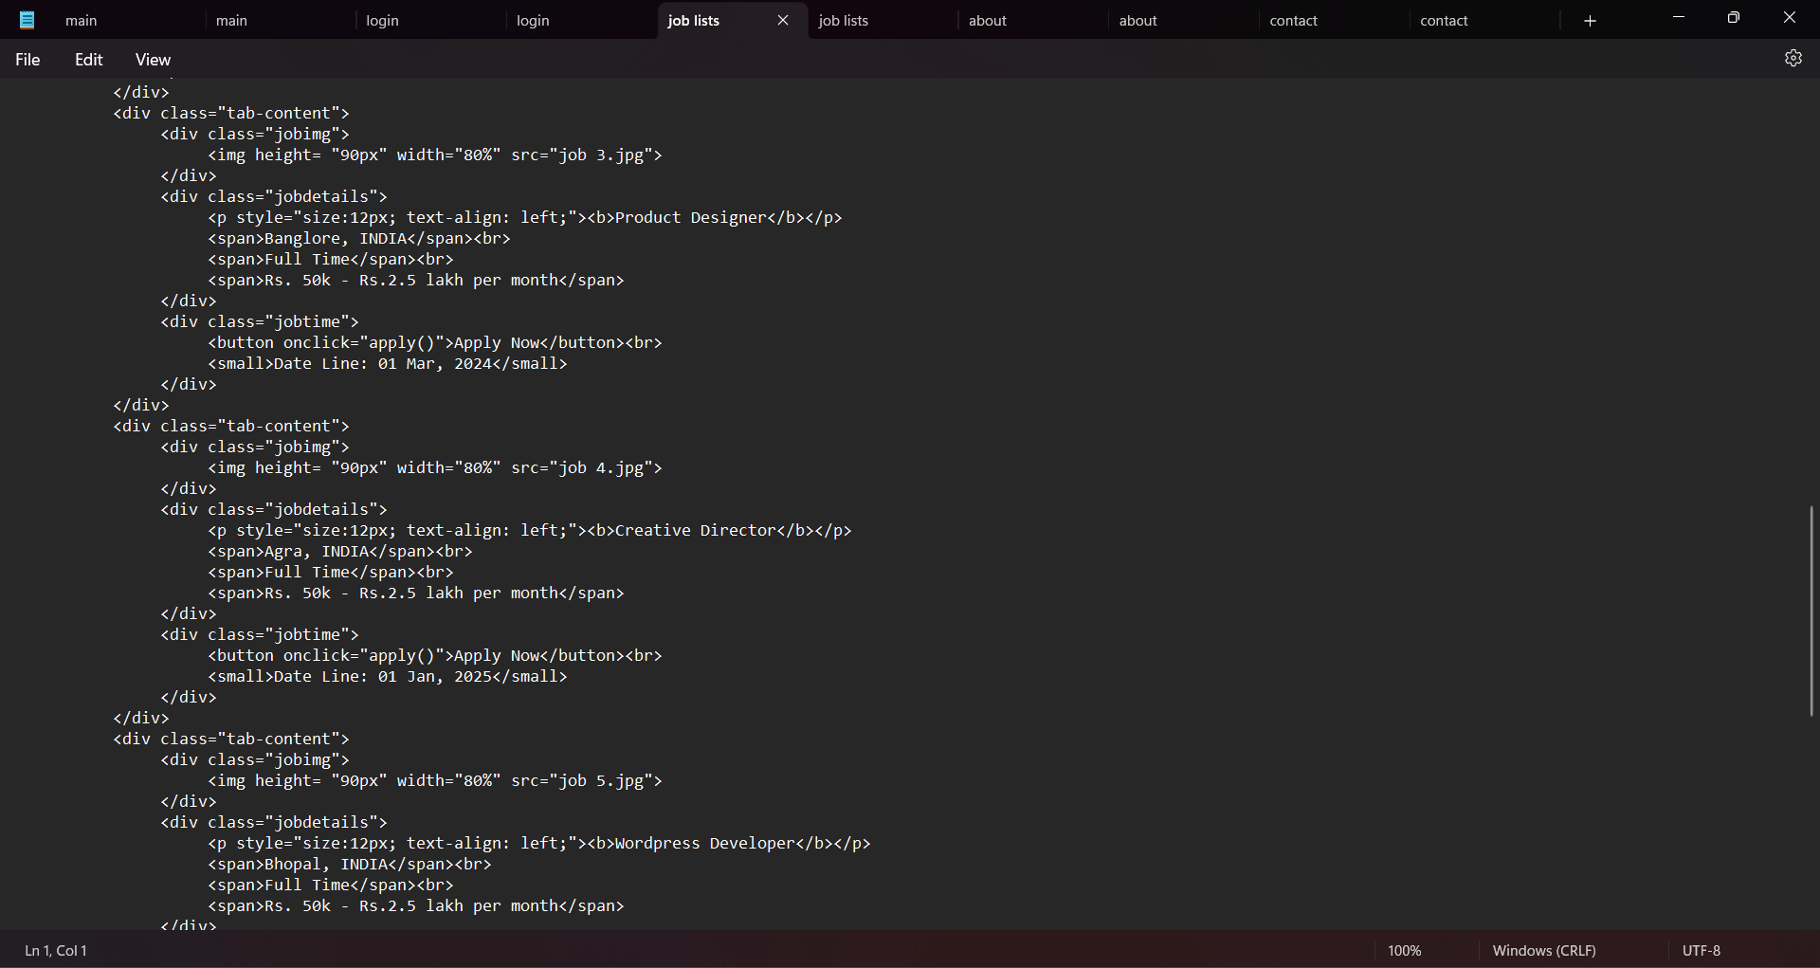

Slide 34
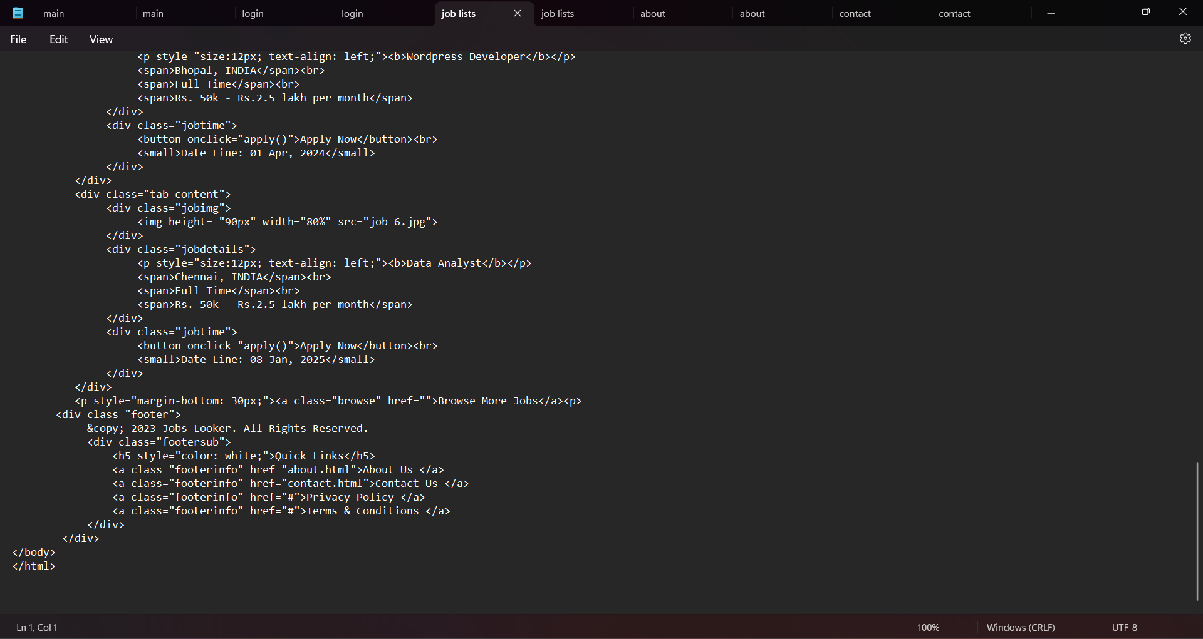

Slide 35
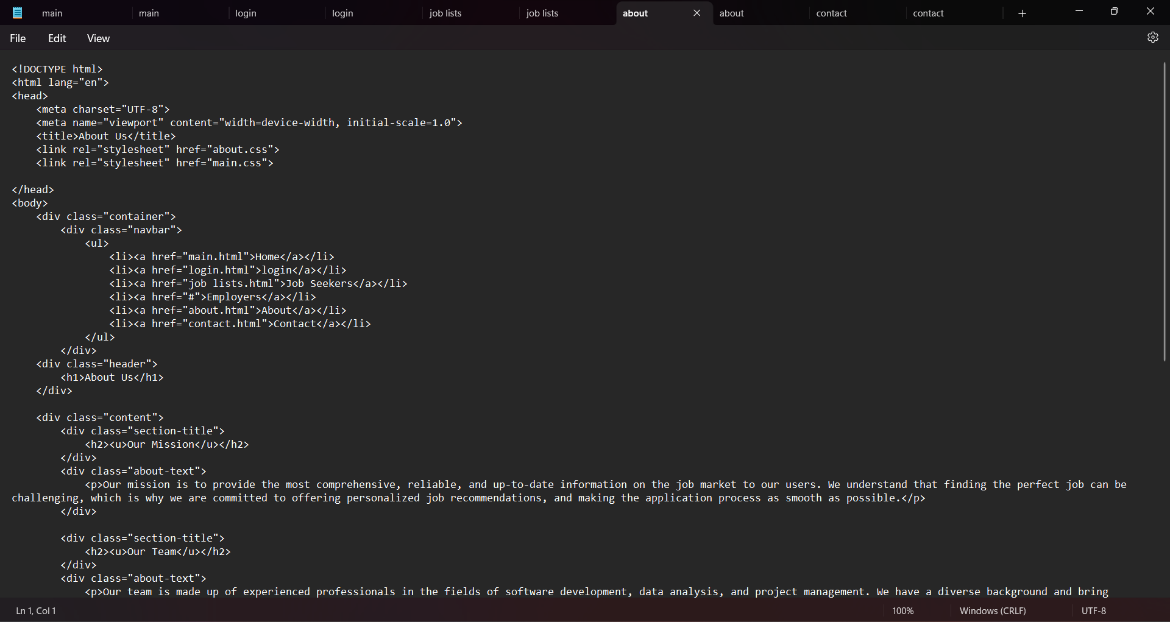

Slide 36
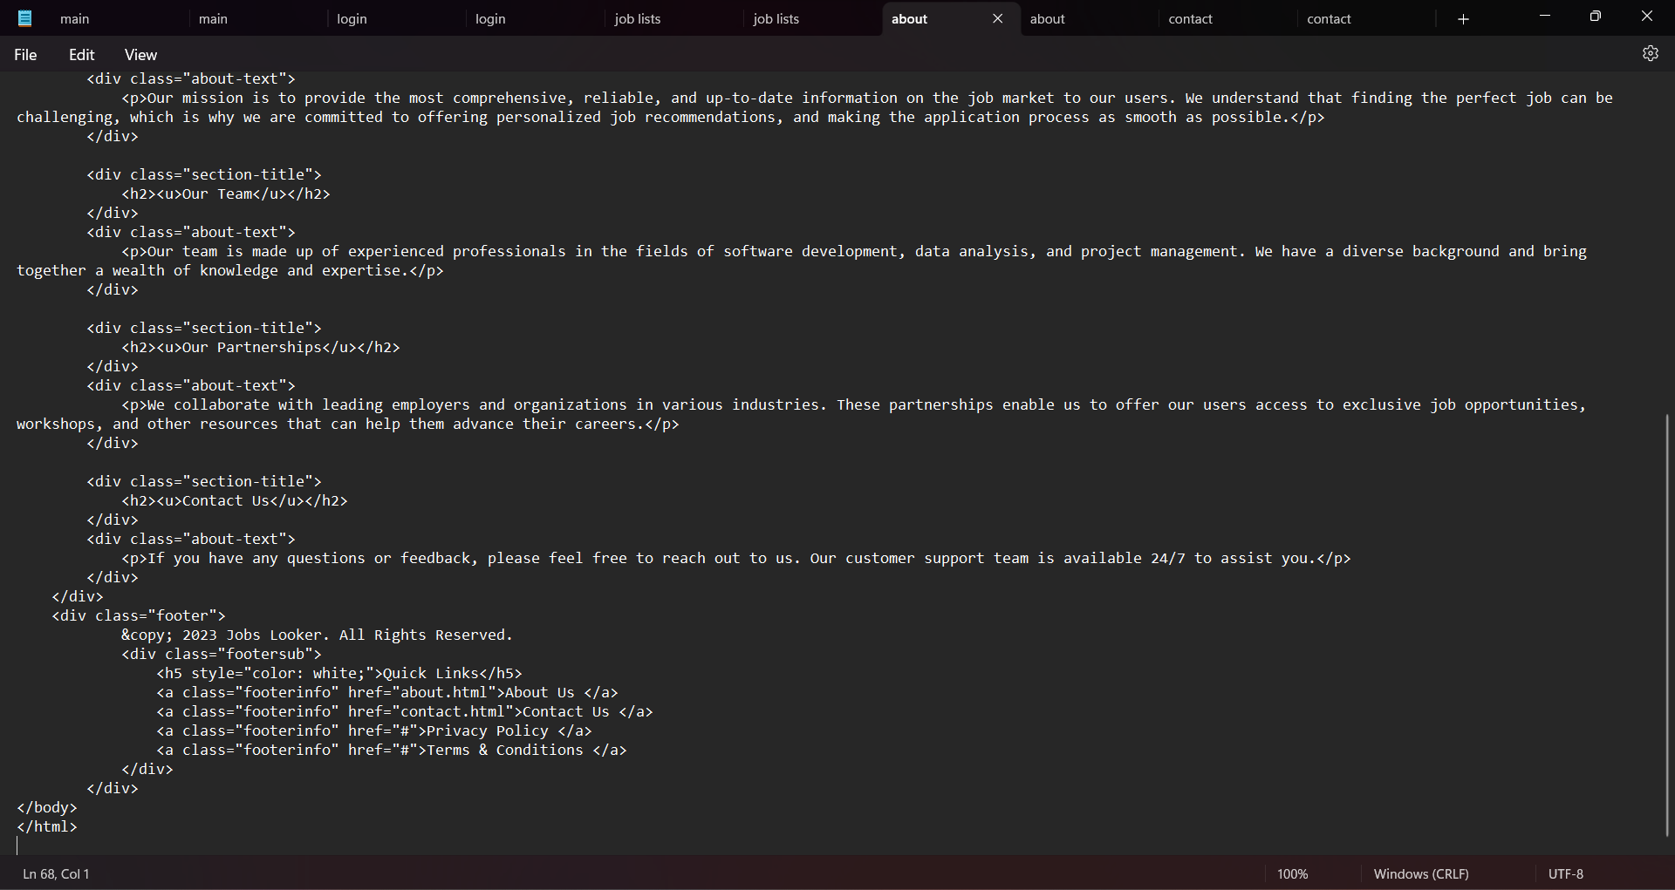

Slide 37
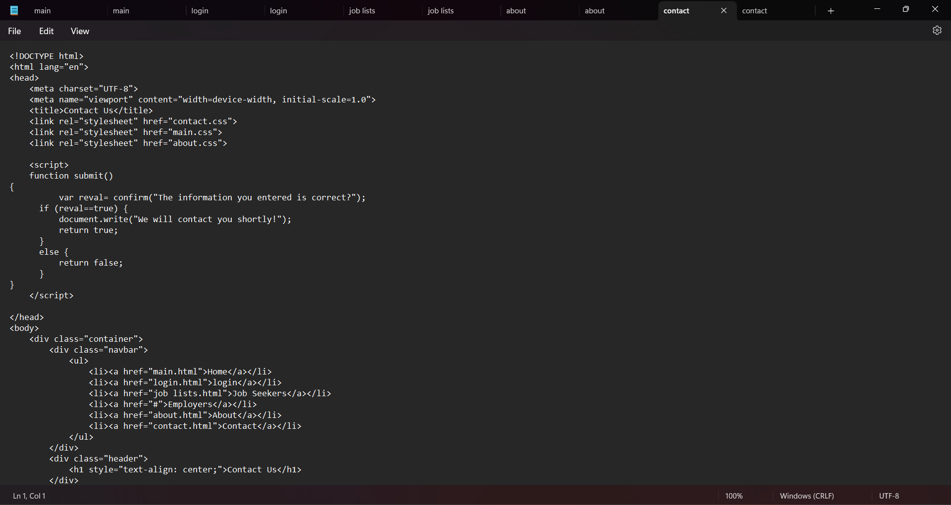

Slide 38
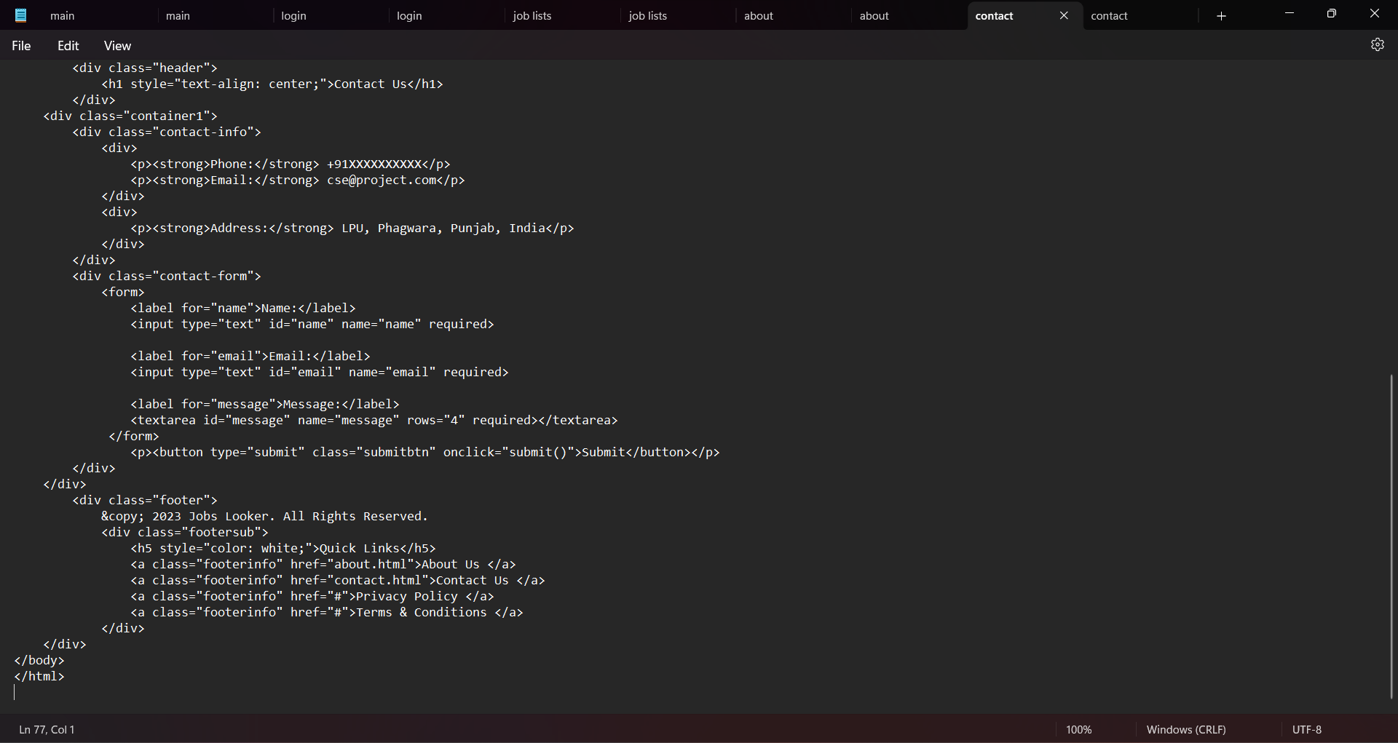

Slide 39
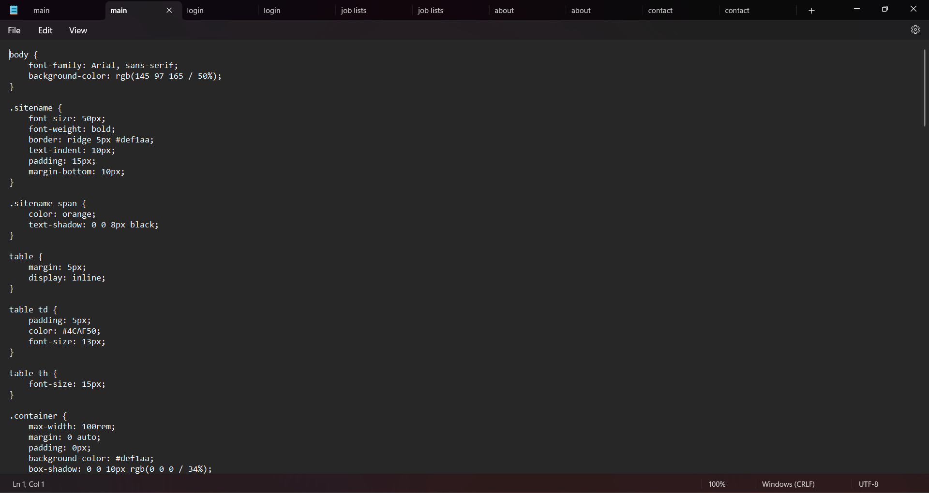

Slide 40
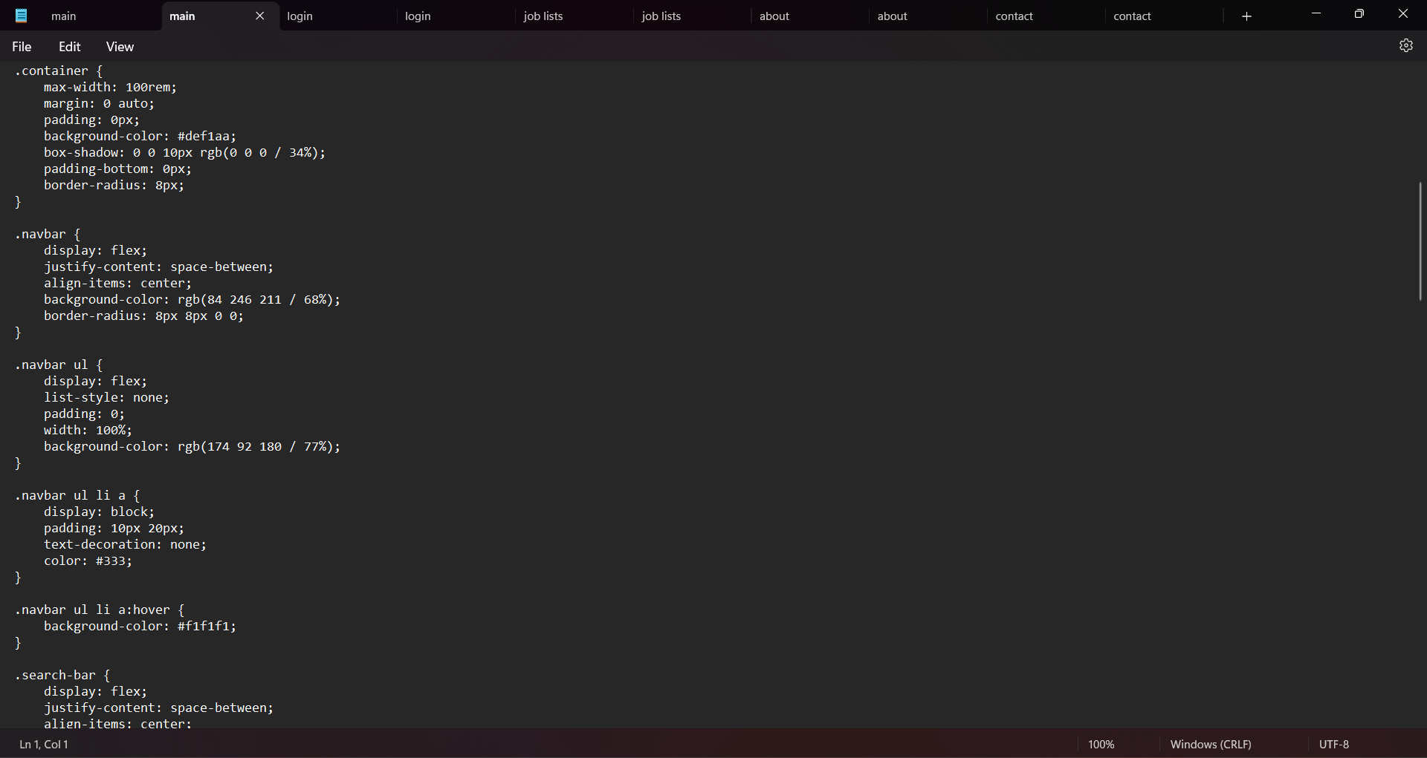

Slide 41
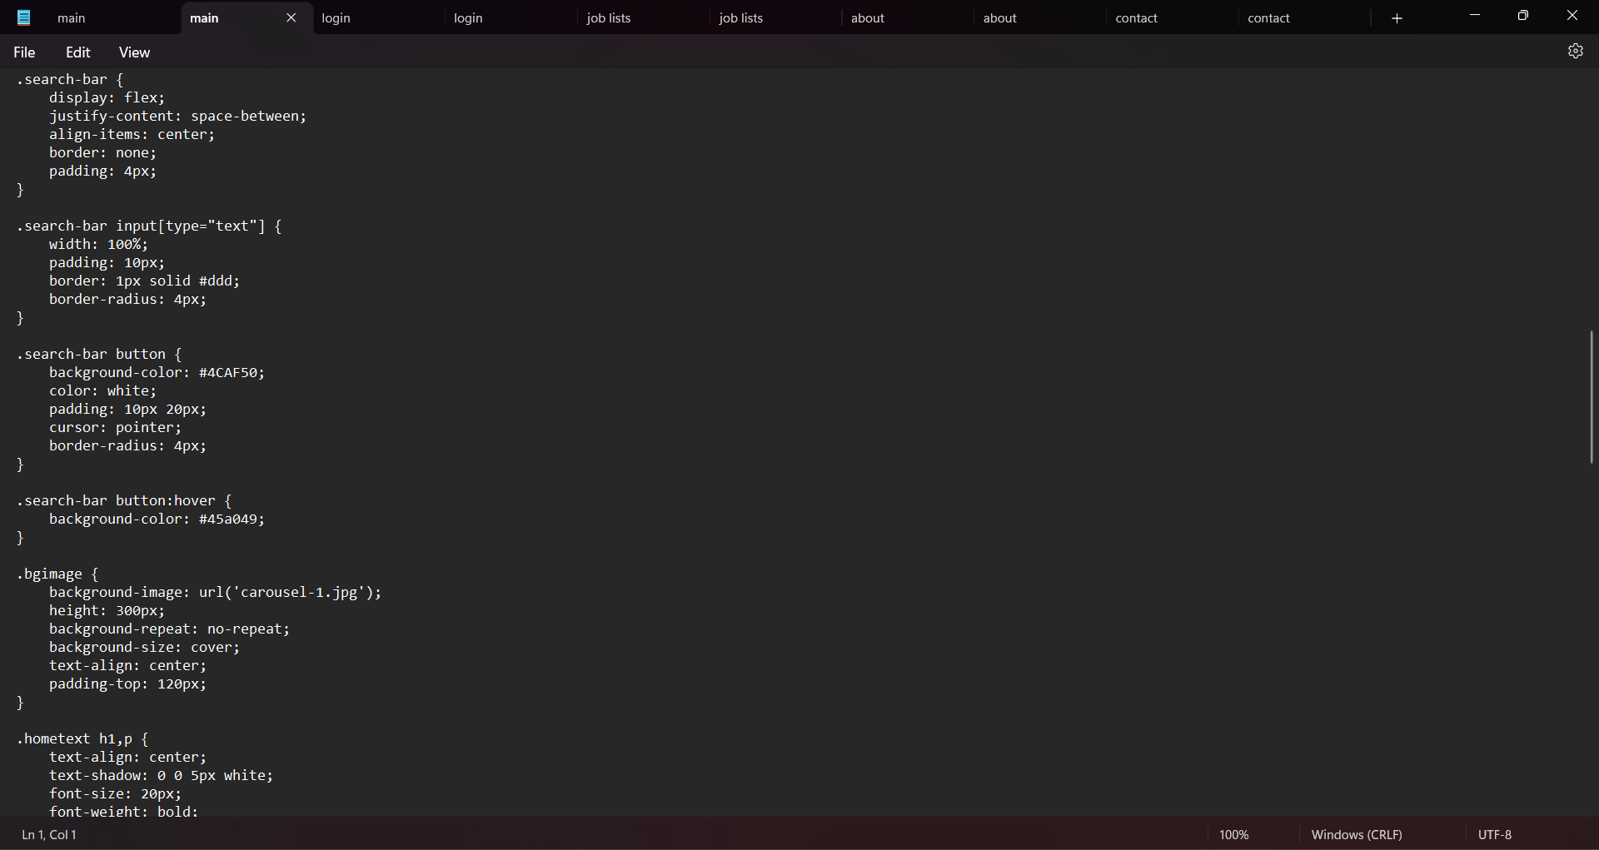

Slide 42
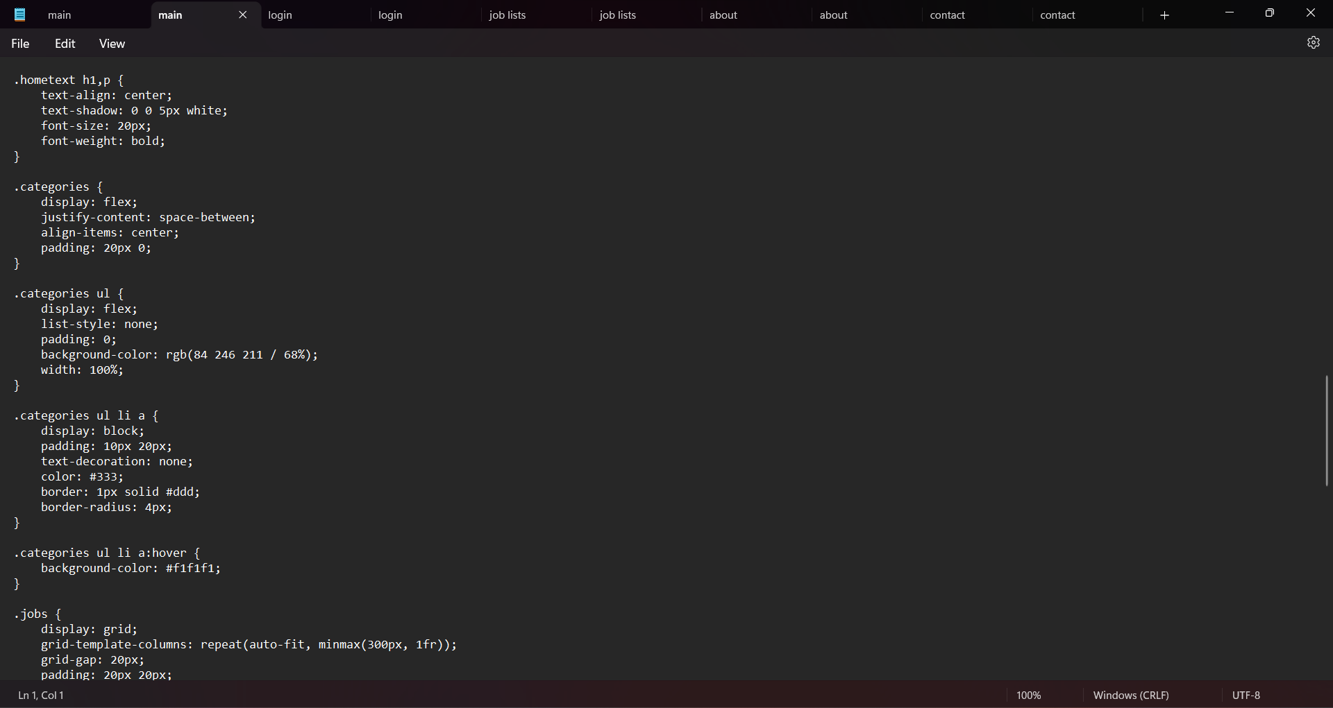

Slide 43
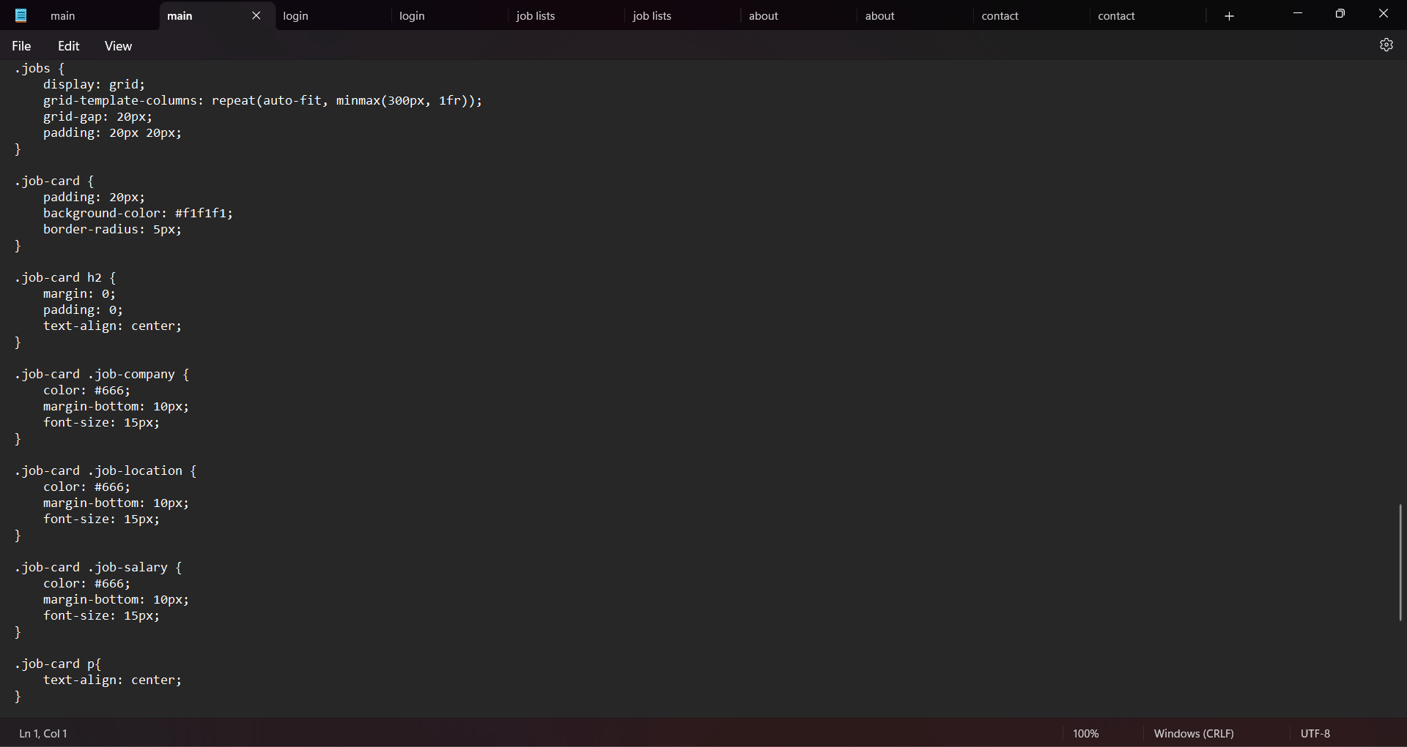

Slide 44
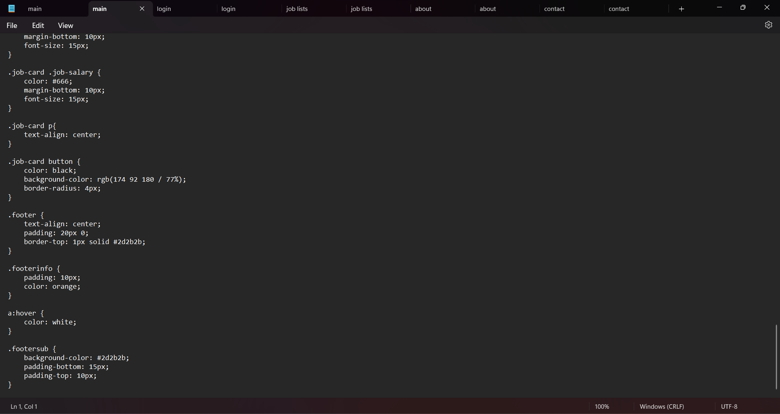

Slide 45
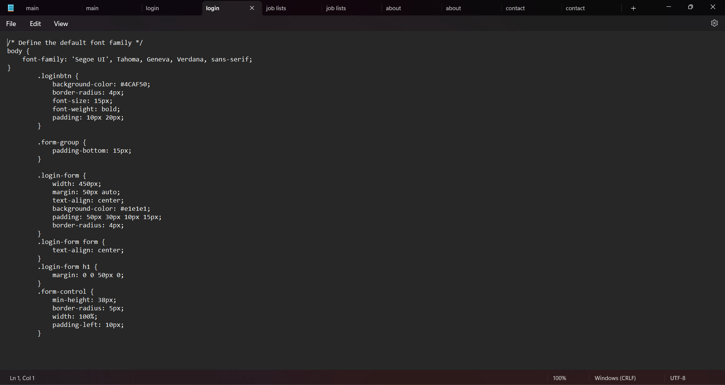

Slide 46
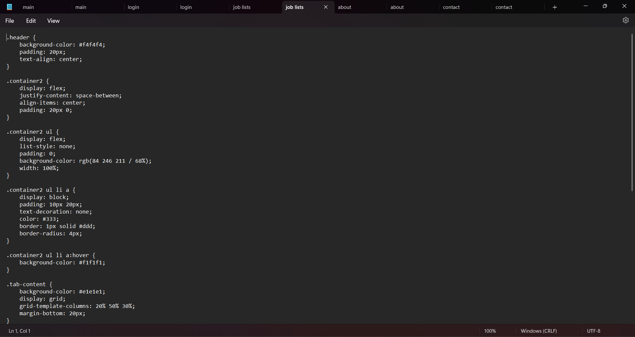

Slide 47
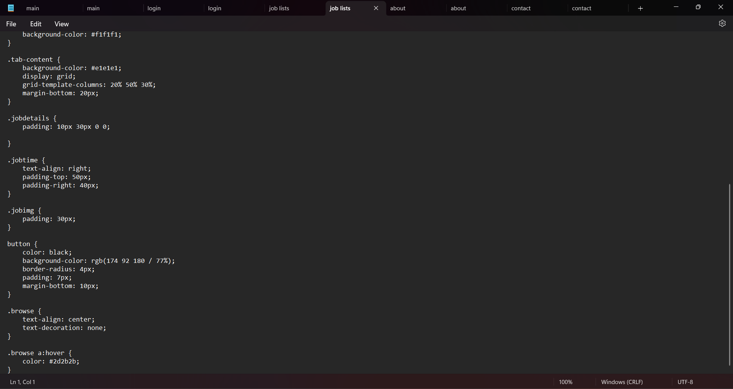

Slide 48
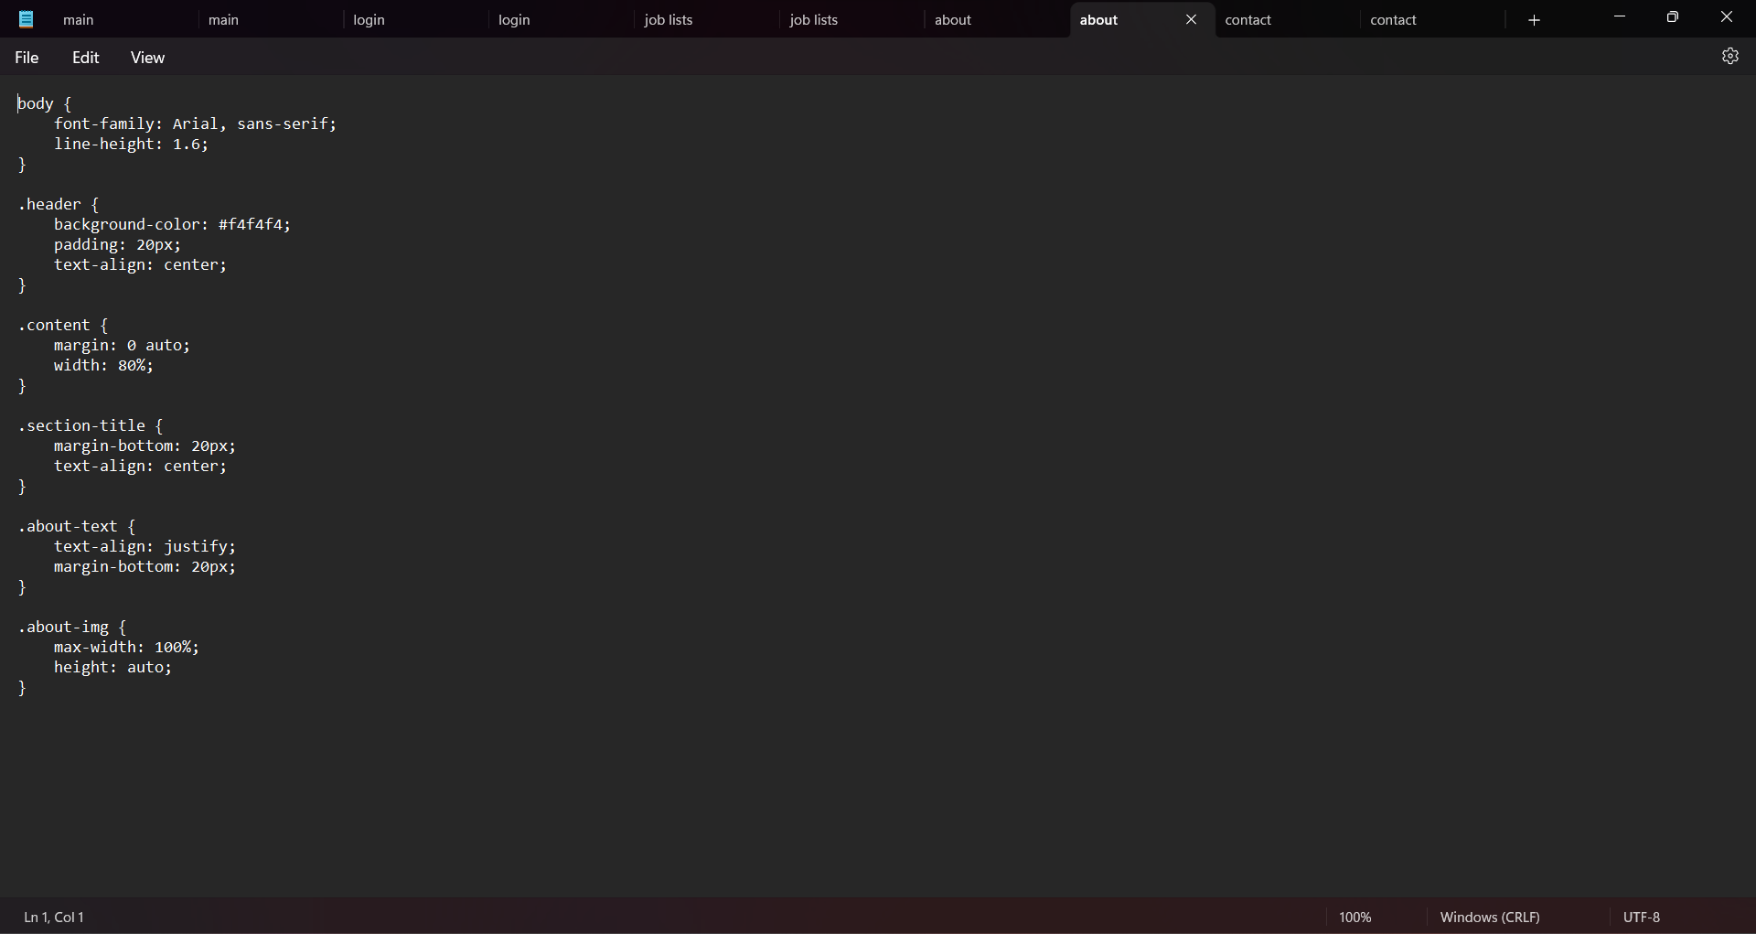

Slide 49
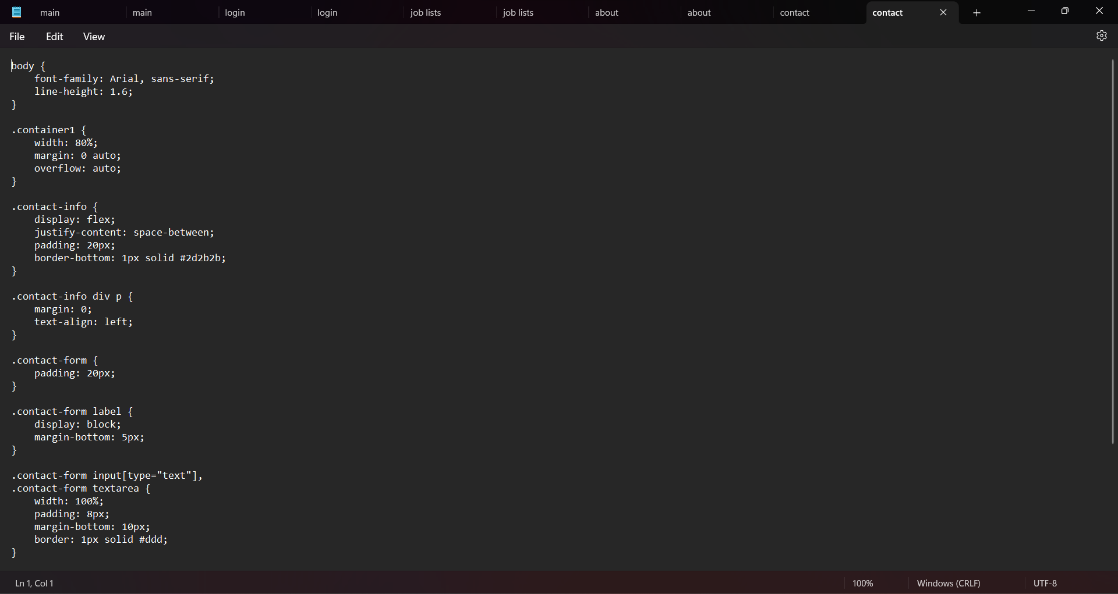

Slide 50
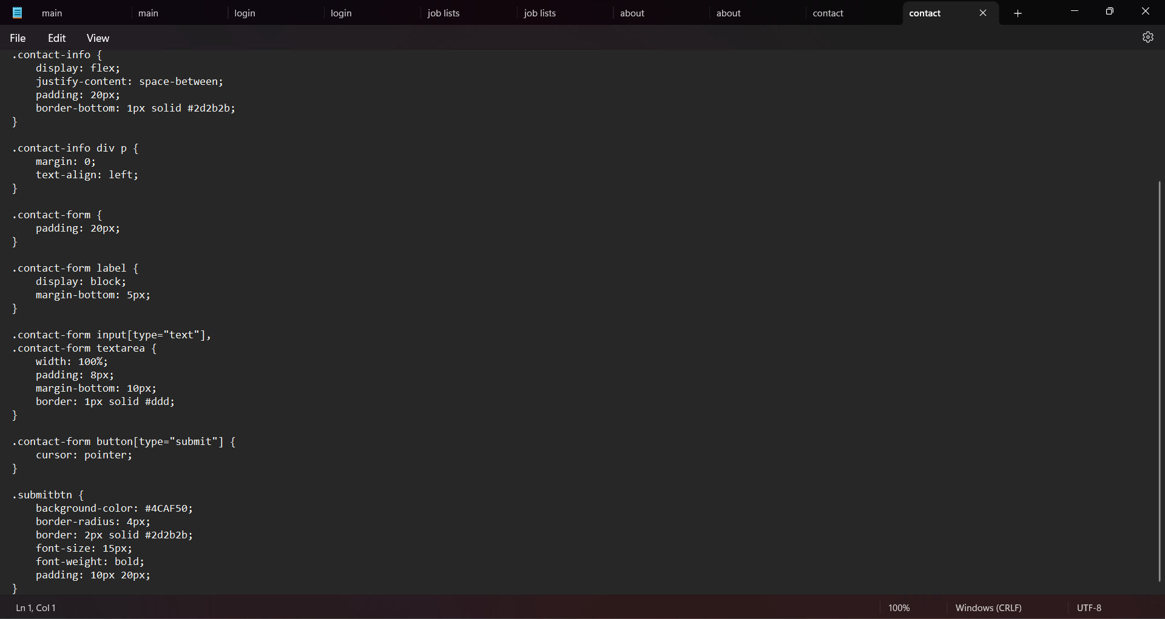

Slide 51
Project Workflow:
Embarking on a web design project as beginners has been both exciting and challenging. Here's a simplified guide to our team workflow:
Kickoff Meeting:
Introduction: Get to know each team member and their strengths.
Project Overview: Understand the project's purpose and what the client or instructor expects.
Planning Together:
Task List: Break down the project into smaller tasks that everyone can handle.
Timeline: Set achievable deadlines for each task to keep the project on track.

Slide 52
3. Learning and Designing:
Study Basics: Begin with the fundamentals of HTML and CSS.
Sketching Ideas: Share design ideas and collaborate on paper before diving into the digital realm.
4. Building the Website:
Collaborative Coding: Use simple code snippets and learn from each other.
GitHub Basics: Familiarize yourselves with GitHub for version control and collaborative coding.
5. Testing Together:
Group Testing: Check the website on different browsers and devices together.
Peer Feedback: Give and receive constructive feedback within the team.
6. Refinement Stage:
Iterative Approach: Make improvements based on feedback.
Learn as You Go: Don't worry if things aren't perfect initially; it's a learning process.

Slide 53
7. Finalization:
Polishing Up: Add final touches, such as colors, fonts, and any additional features.
Responsive Design: Ensure the website looks good on various screens.
8. Presentation and Reflection:
Team Showcase: Present the final project to classmates or instructors.
Reflect and Learn: Discuss what worked well, what could be improved, and what you learned from the experience.
Remember, as beginners, the focus is not just on the final product but also on the learning journey. Embrace challenges, celebrate small victories, and most importantly, enjoy the collaborative process of creating something new.

Slide 54
CONCLUSION:
Building this job portal has been a valuable learning experience. We have gained insights into the challenges and opportunities of creating a user-friendly and informative job portal that effectively connects job seekers with potential employers.
We have learned the importance of providing clear and concise job descriptions, designing an intuitive and easy-to-navigate interface, and incorporating robust search and filtering functionality to help job seekers quickly find relevant openings. We have also gained a deeper appreciation for the critical role that job portals play in matching qualified candidates with suitable job opportunities.
Thank you for your support!

Slide 55
REFERENCES:
W3SCHOOL: https://www.w3schools.com
MDN Web Docs: https://developer.mozilla.org
SOME YOUTUBE VIDEOS:
CodeHelp – By Babbar
Apna College

